Slide 1

Data Lifecycle Management and Data Governance
A Comprehensive Framework for Enterprise Data Strategy
Dr Arun Ayyar

Slide 2


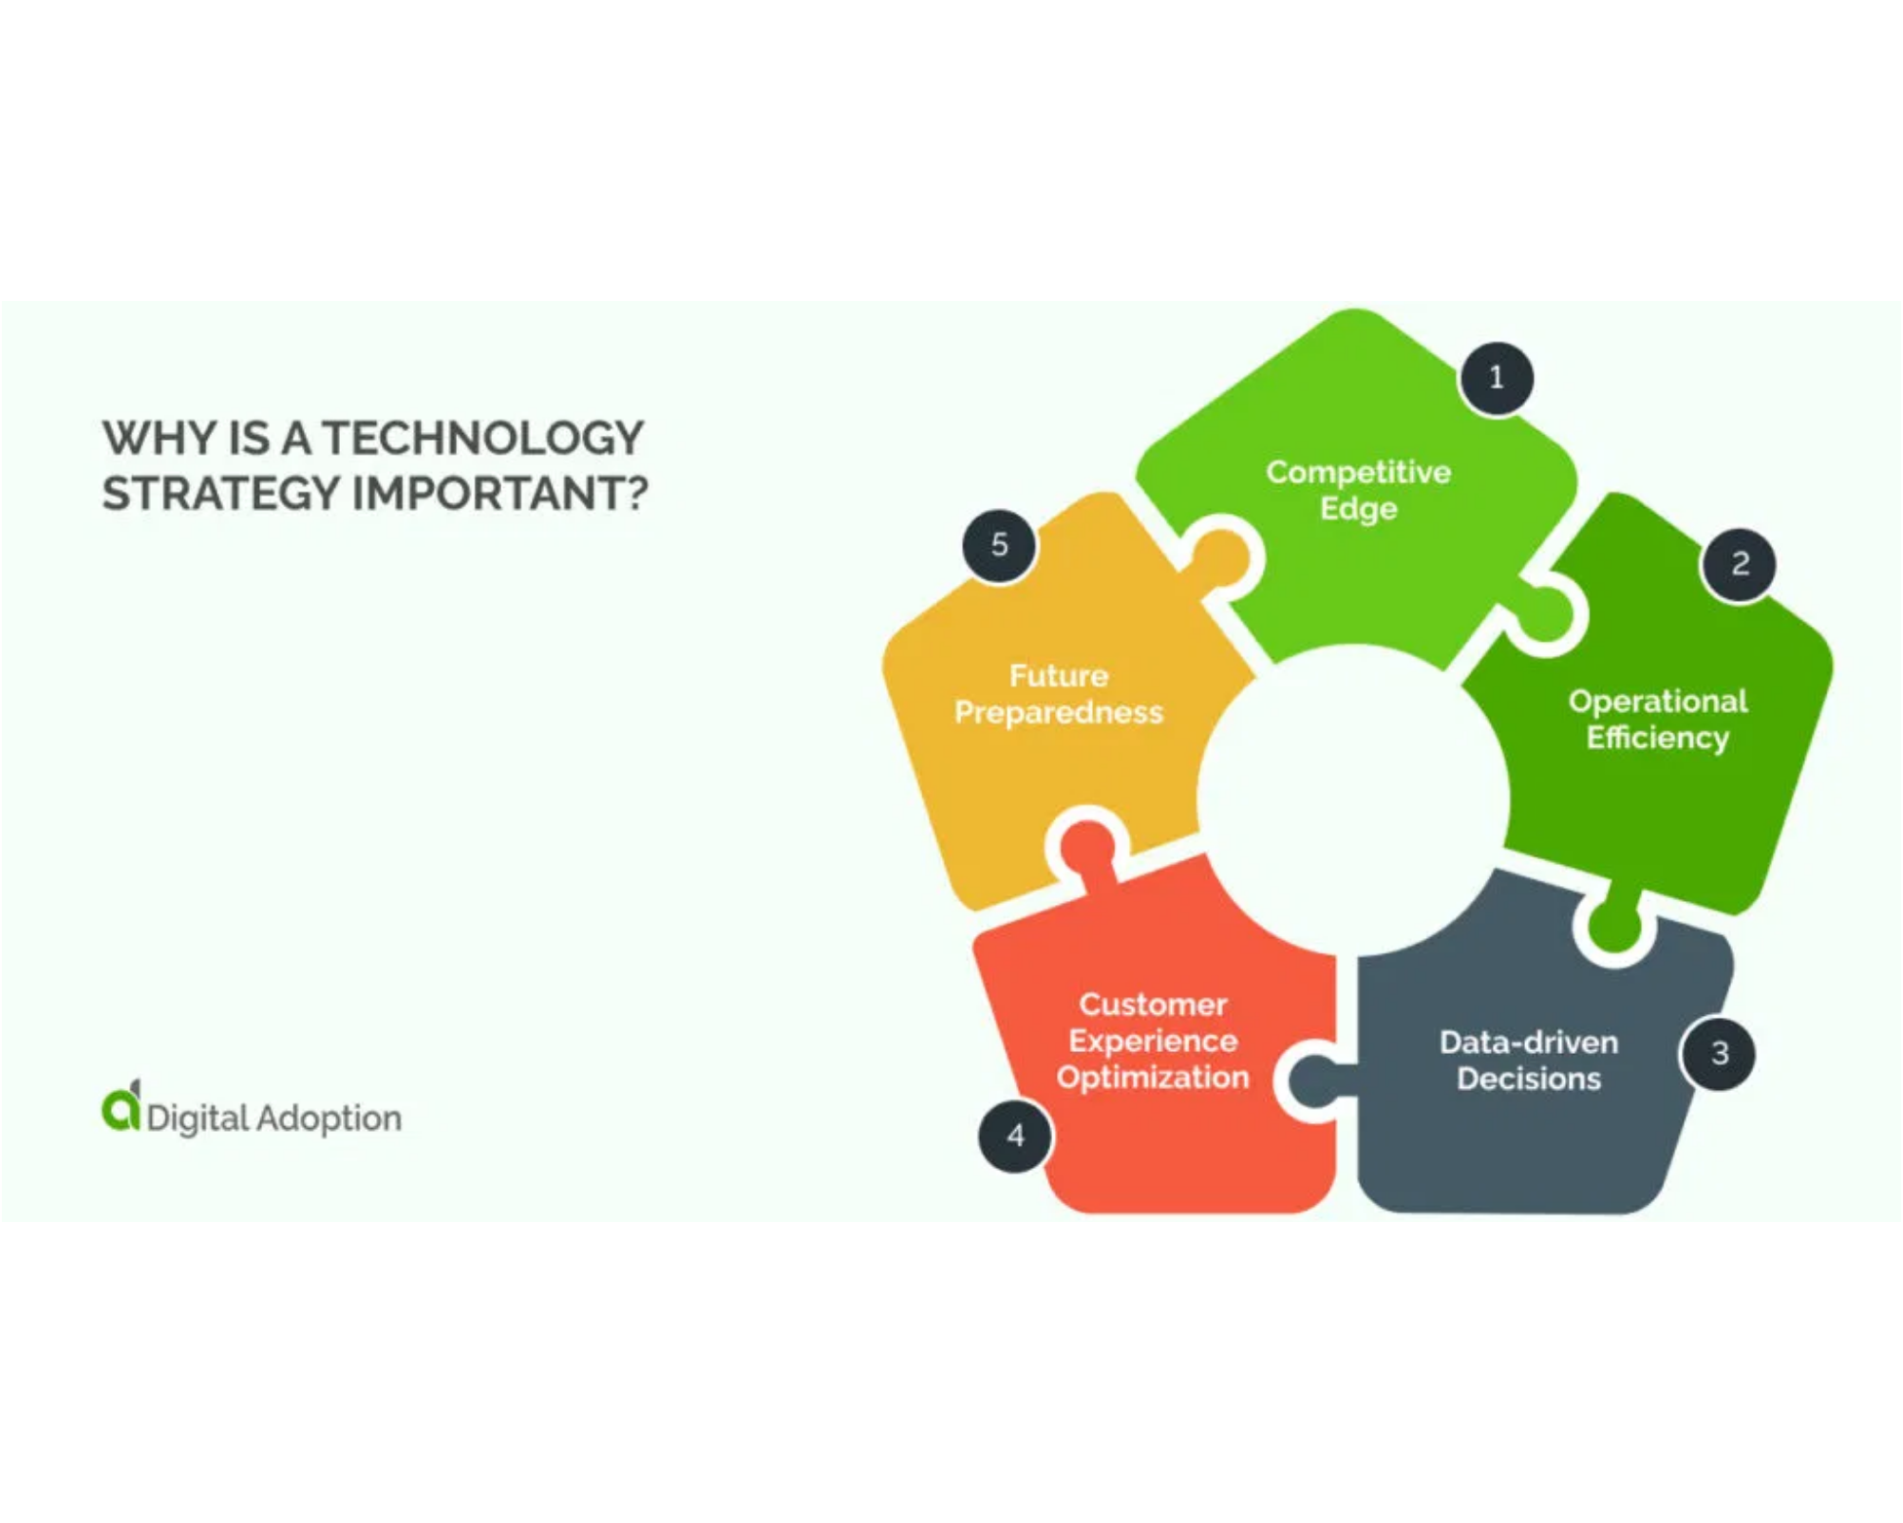

Agenda and Learning Objectives
What We'll Cover
1. Introduction and Data Challenges
2. Data Lifecycle Management Fundamentals
3. Data Governance Framework
4. Integration and Implementation
5. Data Privacy
Key Learning Objectives
Understand the complete data lifecycle from creation to deletion
Master data governance principles and frameworks
Learn implementation strategies and overcome challenges
Build a data-driven culture in your organization
Data Lifecycle Management and Data Governance | Page 2

Slide 3




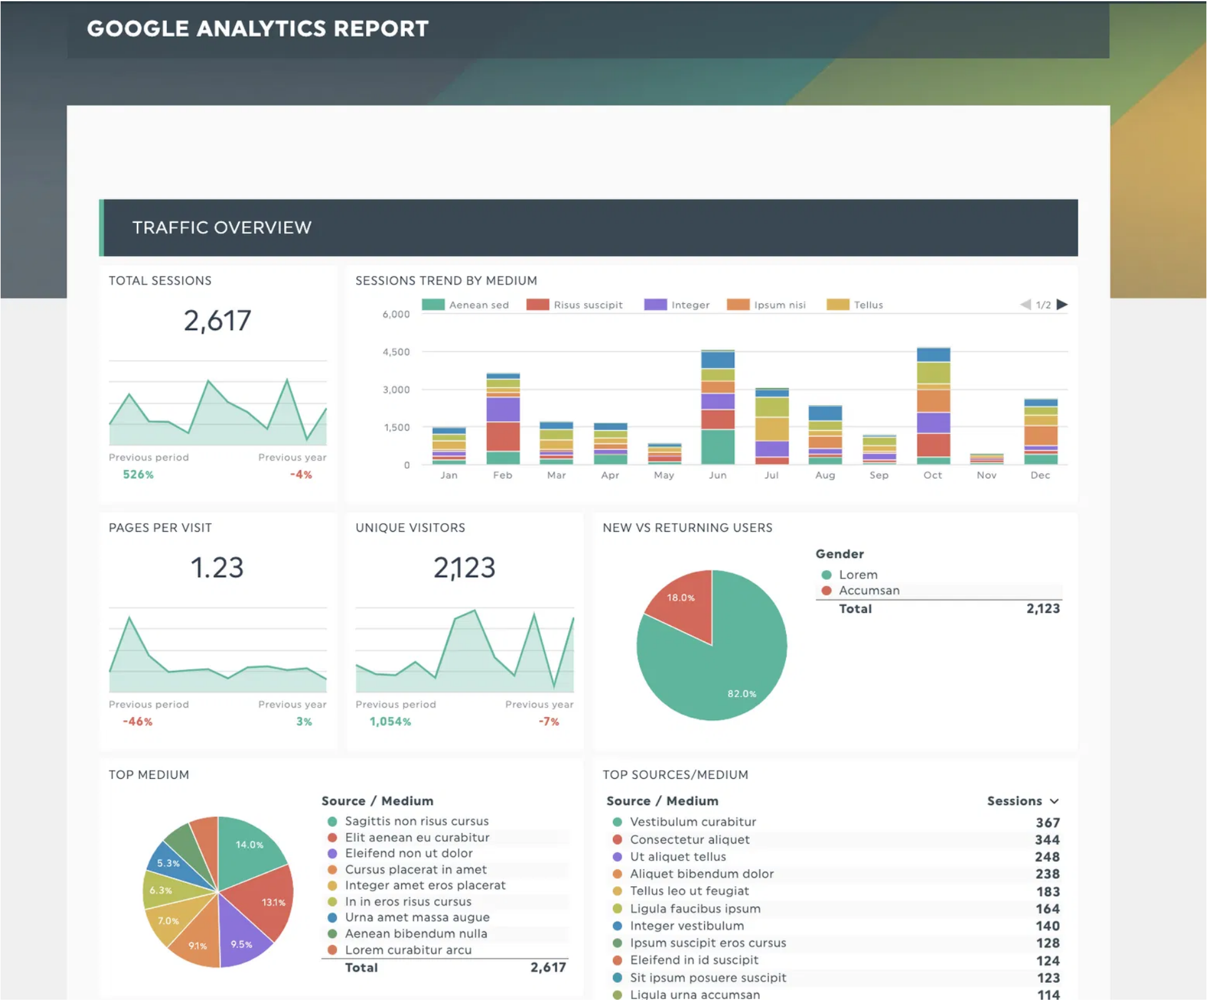




The Data Challenge
Current State of Enterprise Data
Exponential data growth across all business functions
Siloed data systems creating fragmented views
Increasing regulatory requirements (GDPR, CCPA, etc.)
The 3Vs Challenge
Volume:
2.5 quintillion bytes of data created daily
Velocity:
Real-time data processing requirements
Variety:
Structured, unstructured, and semi-structured
data
Cost of Poor Data Management
• Poor data quality costs organizations
$12.9 million
annually
• Data breaches cost
$4.35 million
per incident on average
•
68%
of companies struggle with data silos
Data Lifecycle Management and Data Governance | Page 3

Slide 4


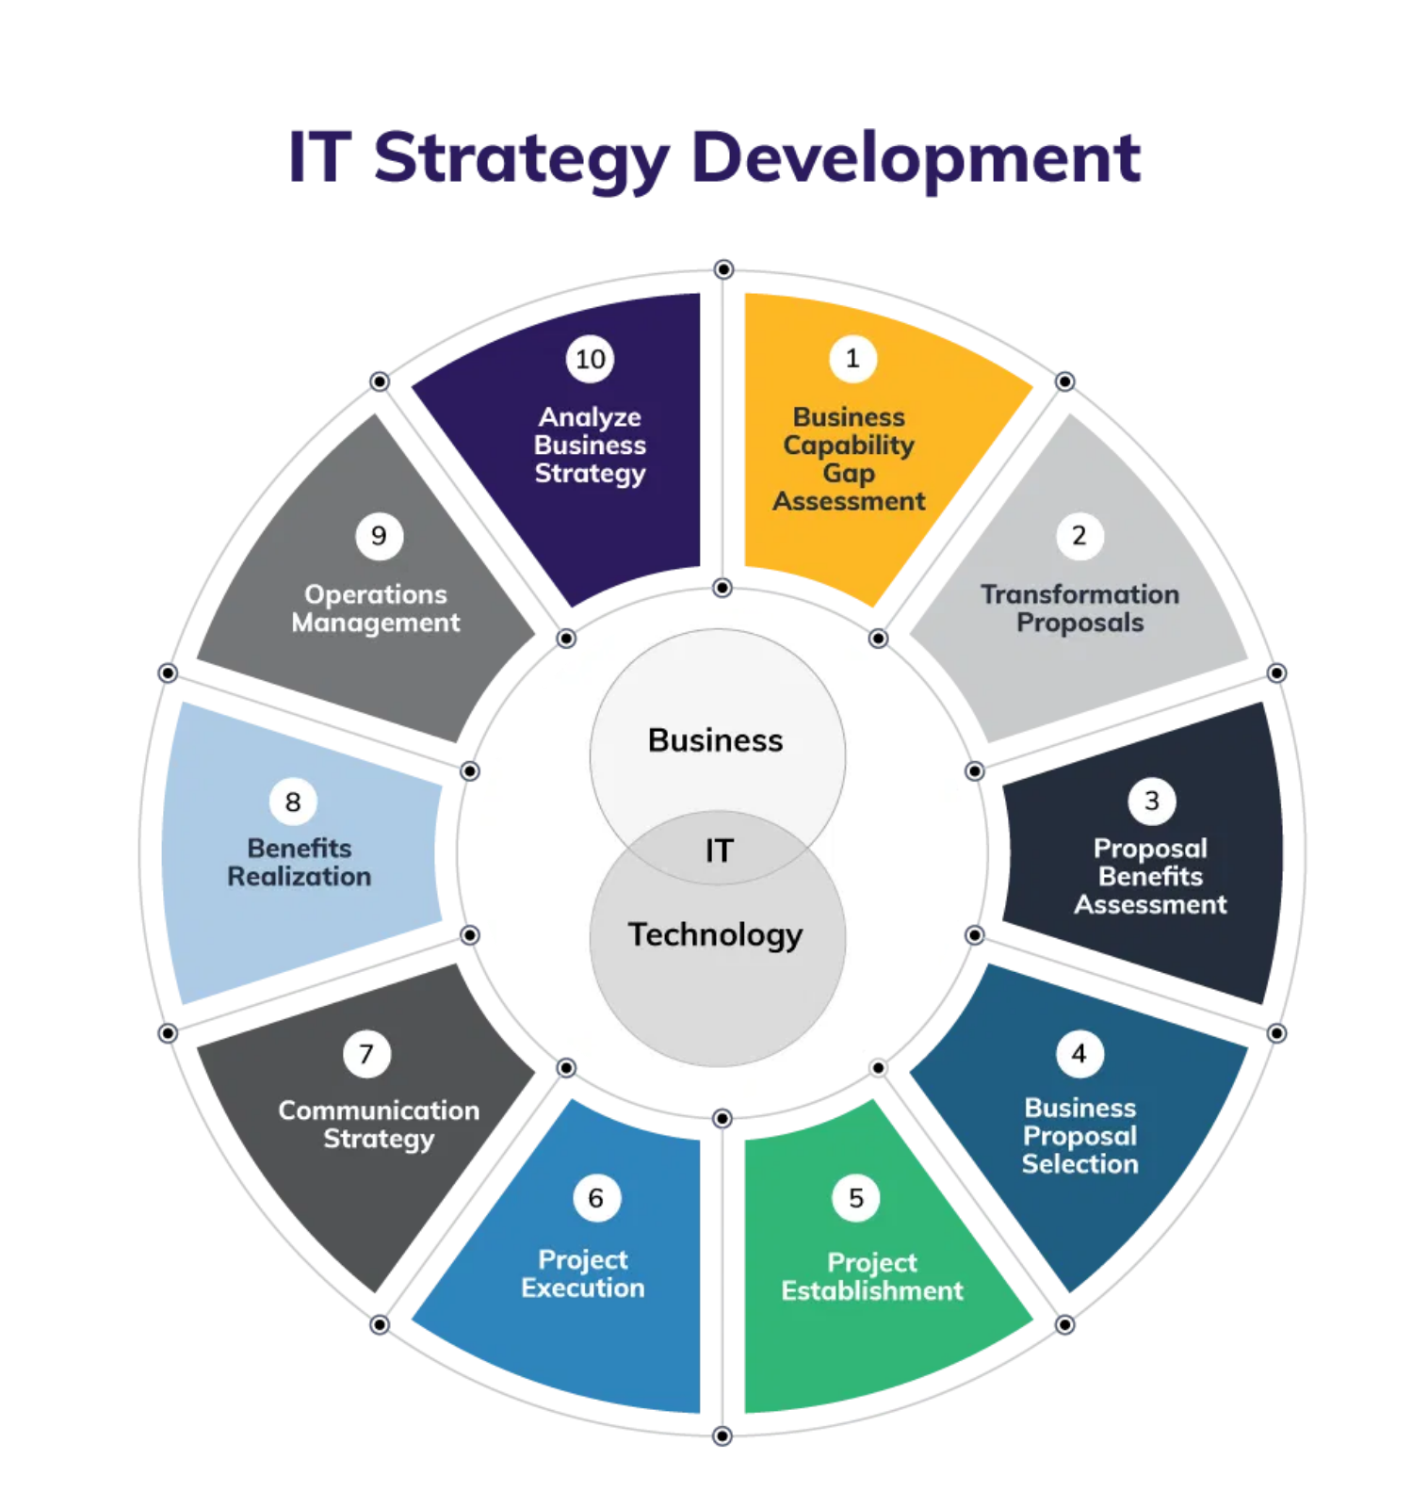


Introduction to Key Concepts
Data Lifecycle Management (DLM)
An approach to managing data throughout its entire lifecycle, from creation to deletion. DLM involves policies and processes that maximize data value at each stage while ensuring security, compliance, and efficiency.
Data Governance
The framework that defines authority, control, and decision-making over data assets. It establishes roles, responsibilities, policies, and standards to ensure data is treated as a valuable organizational asset.
How They Work Together
Data Governance provides the
strategic framework
while
DLM offers the
tactical implementation
Governance establishes
who
makes decisions; Lifecycle
management determines
how
data flows
Together they create a comprehensive approach to
data as an enterprise asset
Data Lifecycle Management and Data Governance | Page 4

Slide 5

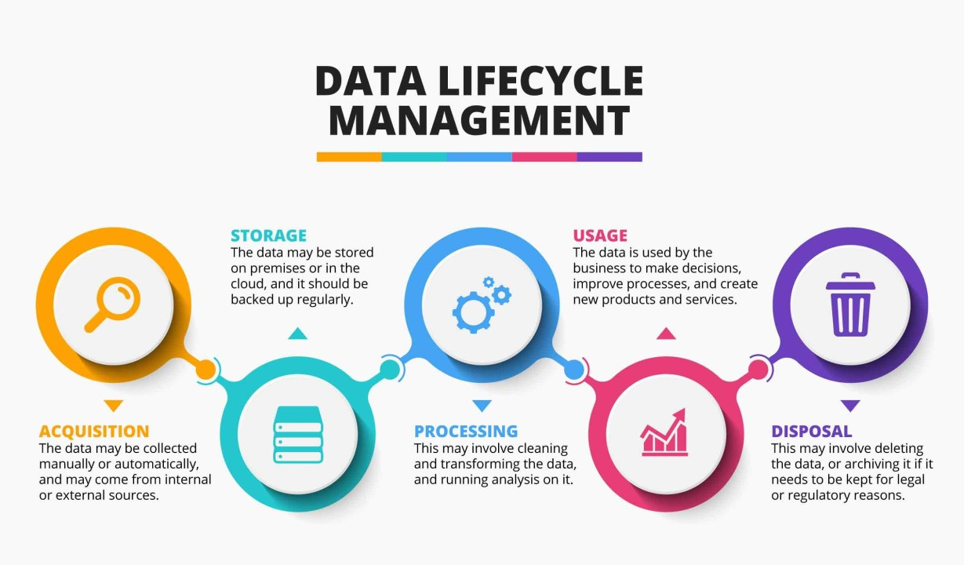


What is Data Lifecycle Management?
Definition
Data Lifecycle Management (DLM) is an approach to managing data throughout its entire lifecycle, from creation and initial storage to the time when it becomes obsolete and is deleted.
Core Purpose
Maximize the value of data throughout its useful life
Ensure data quality, accessibility, and security at each stage
Optimize storage resources and reduce costs
Policy-Driven Approach
Establishes rules for data handling at each lifecycle stage
Automates transitions between stages based on business rules
Ensures compliance with regulatory requirements
Data Lifecycle Management and Data Governance | Page 5

Slide 6



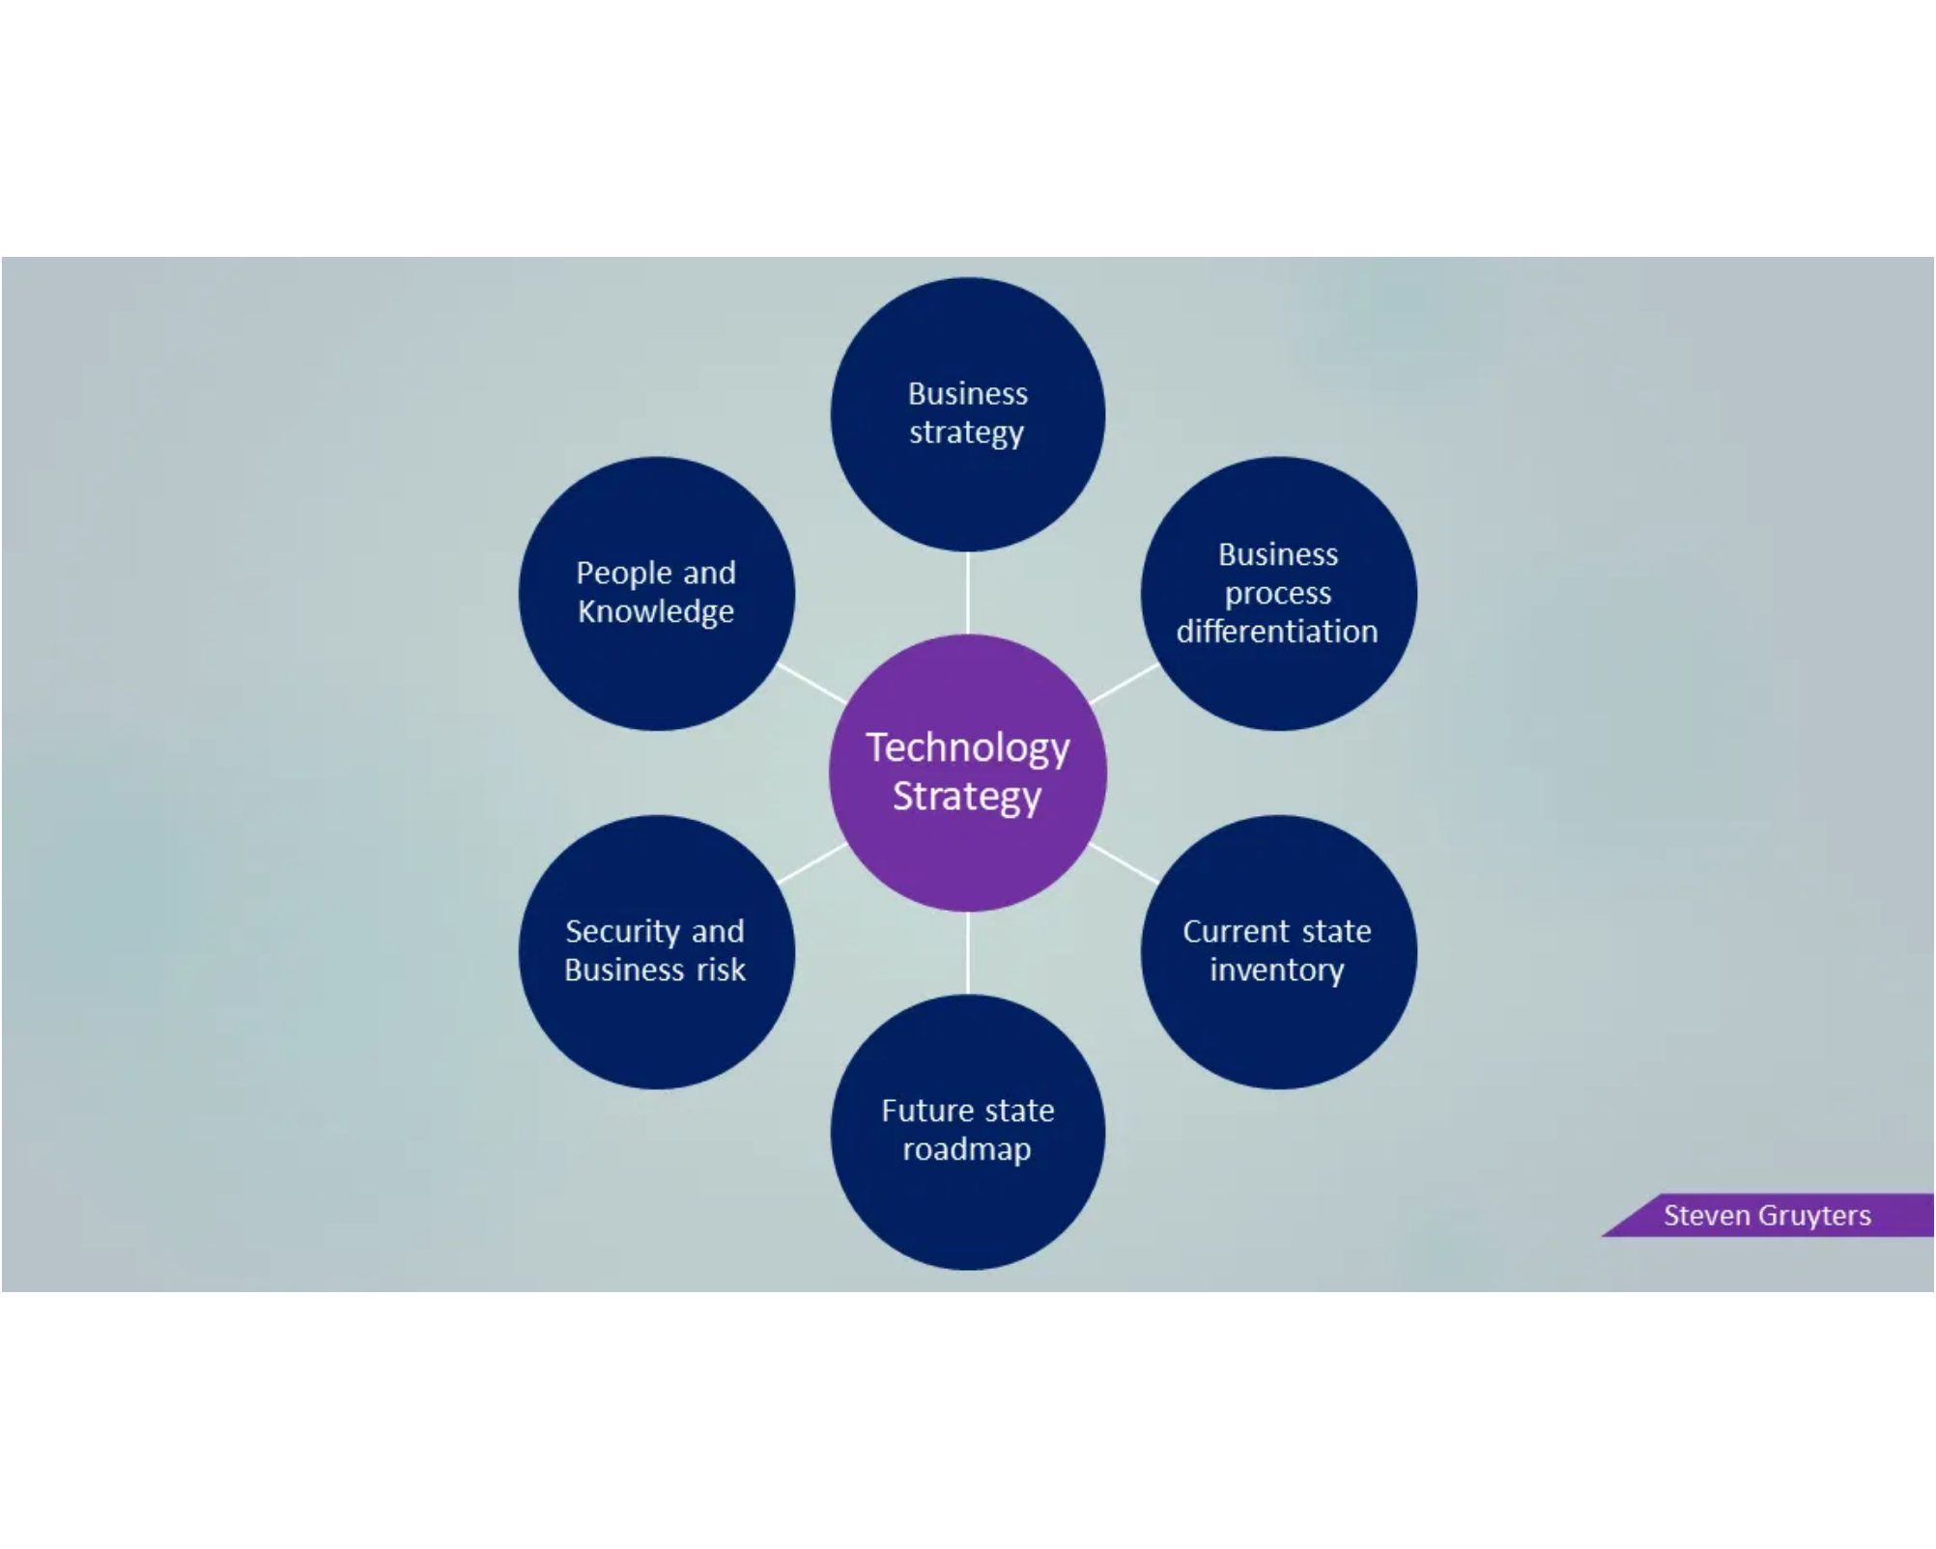
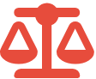





Why DLM Matters
Business Drivers and Benefits
Improved Decision Making:
Access to high-quality,
reliable data across the organization
Operational Efficiency:
Streamlined processes and
reduced redundancy
Risk Mitigation:
Reduced exposure to data breaches and
security incidents
Regulatory Compliance Requirements
GDPR:
Right to be forgotten, data portability
CCPA/CPRA:
Consumer rights over personal data
Industry-specific:
HIPAA, GLBA, SOX, etc.
Cost Optimization Opportunities
Reduced storage costs through proper archiving and deletion
Lower risk of costly data breaches and compliance violations
Improved productivity through better data accessibility
Data Lifecycle Management and Data Governance | Page 6

Slide 7


DLM Models Comparison
Aspect | Harvard 8-Step Model | IBM 5-Phase Model | Alternative Frameworks (lakeFS, DAMA-DMBOK, NIST Big Data)
Focus | Comprehensive, research & analytics oriented | Business/operations oriented | Vary: standards, big data practices, metadata emphasis
Phases/Steps | 1. Generation 2. Collection 3. Processing 4. Storage 5. Management 6. Analysis 7. Visualization 8. Interpretation | 1. Creation 2. Storage 3. Usage 4. Archival 5. Deletion | Typically: Create → Store → Use → Dispose (with extensions for governance, metadata, quality)
Strengths | Rich detail on analytics, insights, and decision-making | Streamlined, easier to implement in business operations | Provide flexibility and industry-specific best practices
Best For | Organizations with strong data science / research focus | Enterprises focused on operational efficiency and compliance | Firms needing standard frameworks or handling big data
Key Limitation | More complex, requires advanced capabilities | Less detail on advanced analytics stages | Sometimes too generic or broad
Harvard 8-Step Model
Comprehensive approach covering the entire data journey:
1. Generation
2. Collection
3. Processing
4. Storage
5. Management
6. Analysis
7. Visualization
8. Interpretation
IBM 5-Phase Model
Business-focused approach emphasizing operational stages:
1. Data Creation
2. Data Storage
3. Data Usage
4. Data Archival
5. Data Deletion
Alternative Frameworks
lakeFS 4-Phase
DAMA-DMBOK
NIST Big Data
Key Differences
• Harvard model emphasizes analytical stages
• IBM model focuses on operational lifecycle
Harvard Business School 8-Step Data Lifecycle Model
• All models share core stages: creation, storage, usage, disposal
Data Lifecycle Management and Data Governance | Page 7

Slide 8






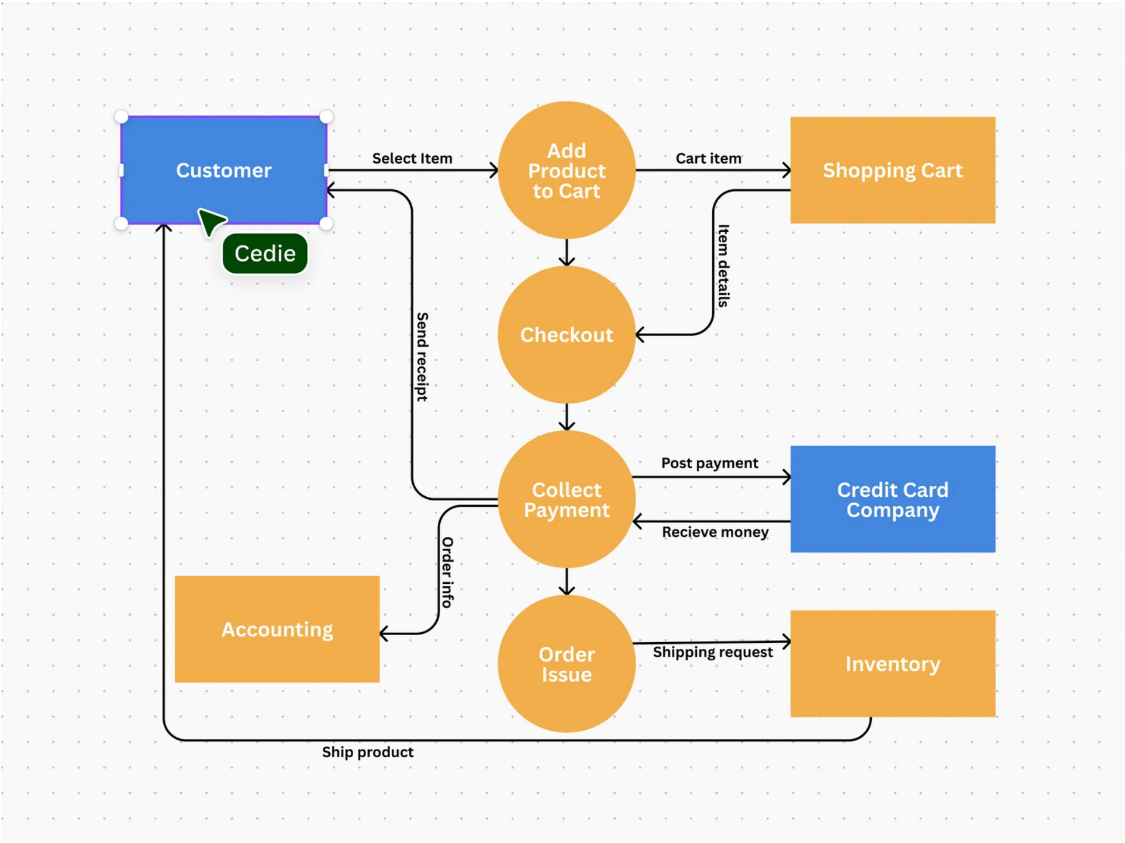

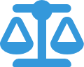

Phase 1: Data Creation/Generation
Data Sources
Web Apps
Mobile
IoT
Forms
Surveys
Customer
Quality vs. Quantity
Not all available data is necessary for business success
Evaluate new data based on quality and relevancy
Collection Best Practices
Define clear data requirements before collection
Implement validation at point of entry
Document metadata during collection
Data Lifecycle Management and Data Governance | Page 8

Slide 9







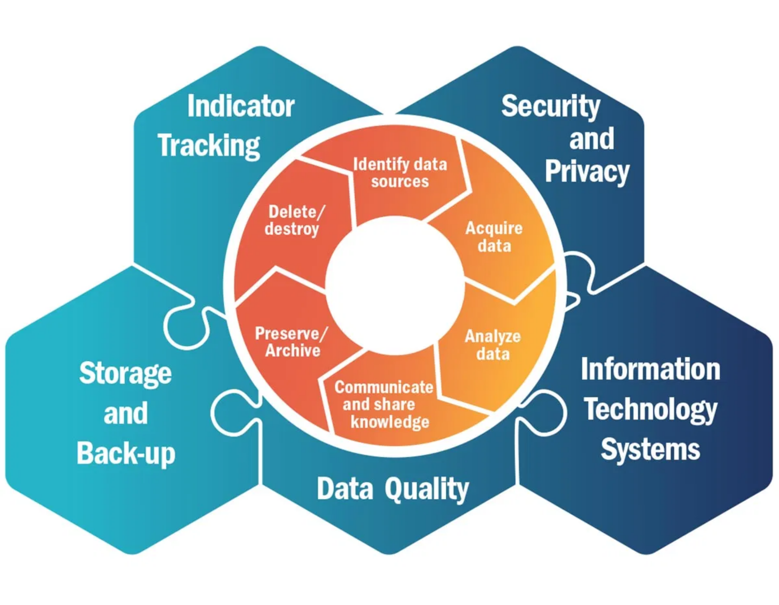





Phase 2: Data Storage
Storage Types and Technologies
Relational DB
NoSQL
Data Lakes
Data Warehouses
Cloud Storage
On-Premises
Structured vs. Unstructured Data
Structured Data
Unstructured Data
Organized in relational databases
Stored in NoSQL or object storage
Fixed schema and format
Flexible schema or no schema
Examples: CRM, ERP data
Examples: emails, documents, media
Security and Encryption
Data encryption (at rest and in transit)
Access controls and authentication
Data Lifecycle Hexagonal Diagram Highlighting Storage Component
Data redundancy and backup
Compliance with privacy regulations
Data Lifecycle Management and Data Governance | Page 9

Slide 10


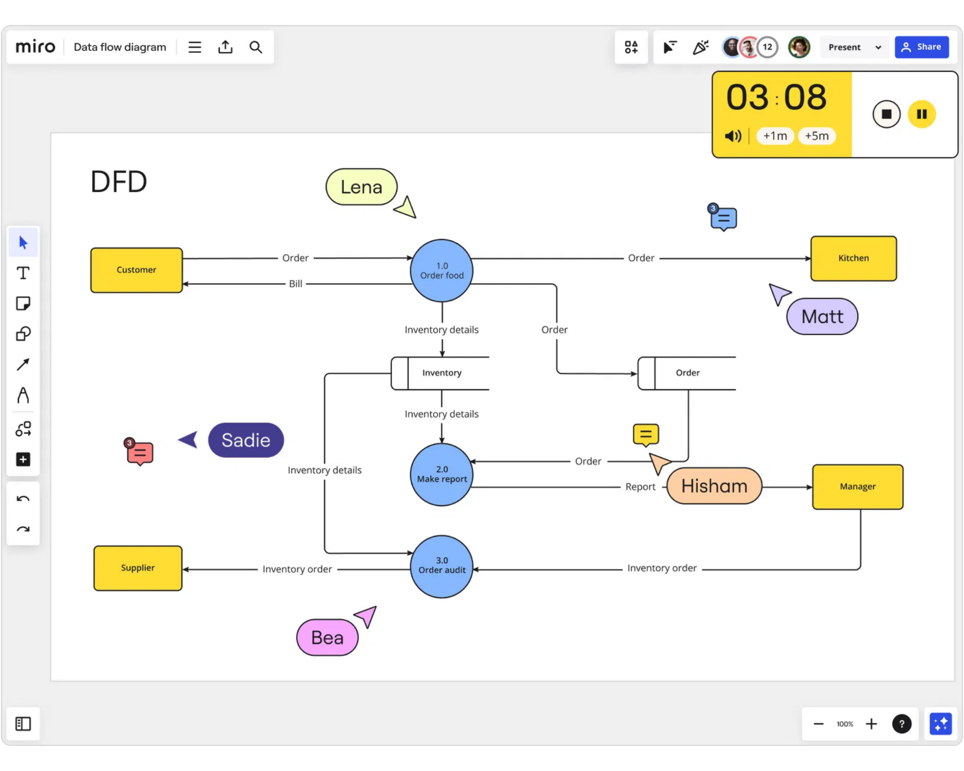













Phase 3: Data Processing and Management
Data Wrangling and Cleaning
Transforming raw data into a more accessible and usable format
Identifying and correcting errors, inconsistencies, and inaccuracies
Transformation Processes
Compression
Encryption
Filtering
Sorting
Normalization
Formatting
Aggregation
Digitization
Ongoing Management Activities
Access control and permission management
Version control and change tracking
Metadata management and documentation
Regular data quality assessments
Data Lifecycle Management and Data Governance | Page 10

Slide 11


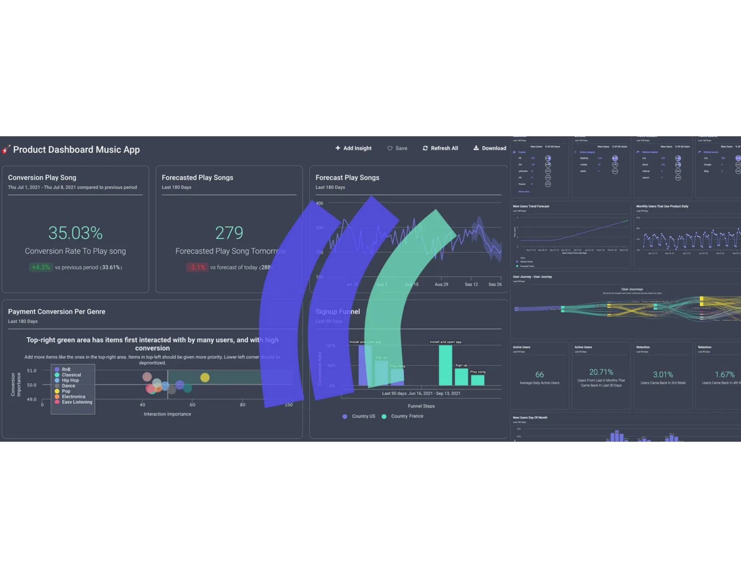










Phase 4: Data Usage and Analysis
Making Data Accessible
Data becomes valuable only when it's accessible to the right people at the right time
Implement role-based access controls to balance accessibility with security
Internal Usage
External Usage
Dashboards & Reports
Marketing Analytics
Decision Support
Partner Integrations
Process Automation
Customer Insights
Analytics & Insights Generation
Descriptive:
What happened?
Diagnostic:
Why did it happen?
Predictive:
What will happen?
Prescriptive:
What should we
do?
Data Lifecycle Management and Data Governance | Page 11

Slide 12

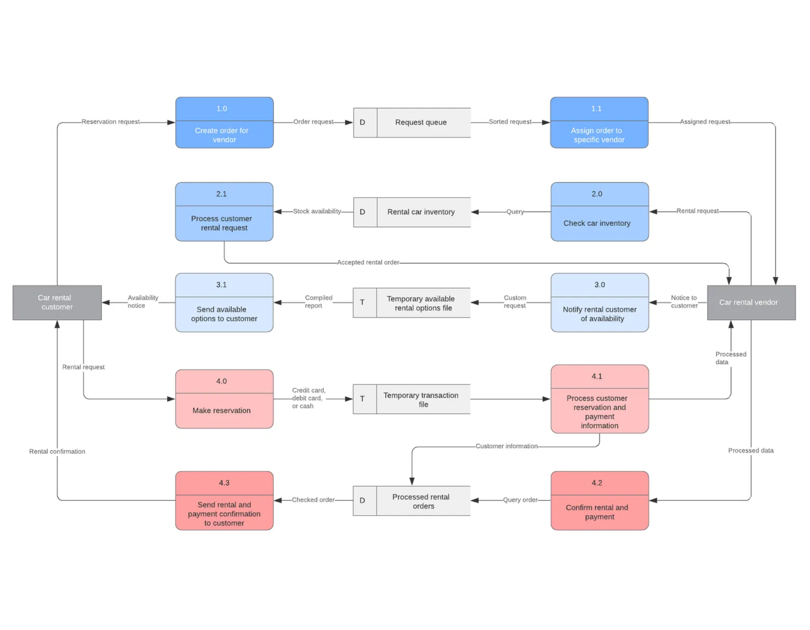






Phase 5: Data Archival
When and Why to Archive
Archive data that is no longer needed for daily operations but must be retained
Reduce primary storage costs while maintaining data accessibility
Preserve historical records for future reference and analysis
Archival Strategies
Compliance Considerations
Time-based:
Archive after
Retention requirements:
predefined periods
Industry regulations
Activity-based:
Archive when
Discoverability:
Searchable for
usage drops
legal discovery
Tiered storage:
Progressive
Security:
Maintain appropriate
cost reduction
controls
Data Flow Diagram Showing Archival Process
Data Lifecycle Management and Data Governance | Page 12

Slide 13


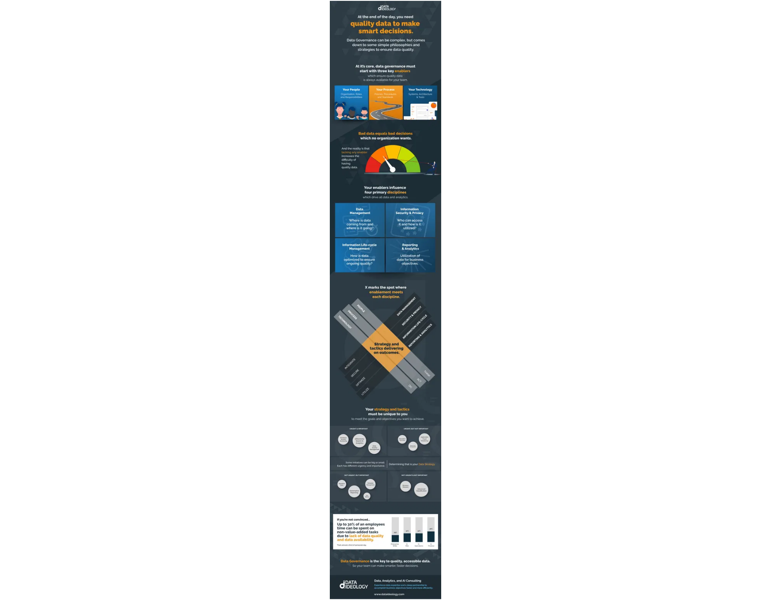



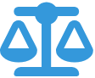




Phase 6: Data Deletion/Destruction
Secure Data Disposal
The final phase ensures data is properly removed when no longer needed
Prevents unauthorized access to sensitive information
Secure Deletion Methods
Digital Sanitization:
Overwriting data multiple times
Cryptographic Erasure:
Destroying encryption keys
Physical Destruction:
For media that cannot be securely wiped
Retention Policy Compliance
Align deletion schedules with legal and regulatory requirements
Storage Optimization Benefits
Reduced storage costs
Decreased security risks
Improved system performance
Documented deletion for audits
Data Lifecycle Management and Data Governance | Page 13

Slide 14




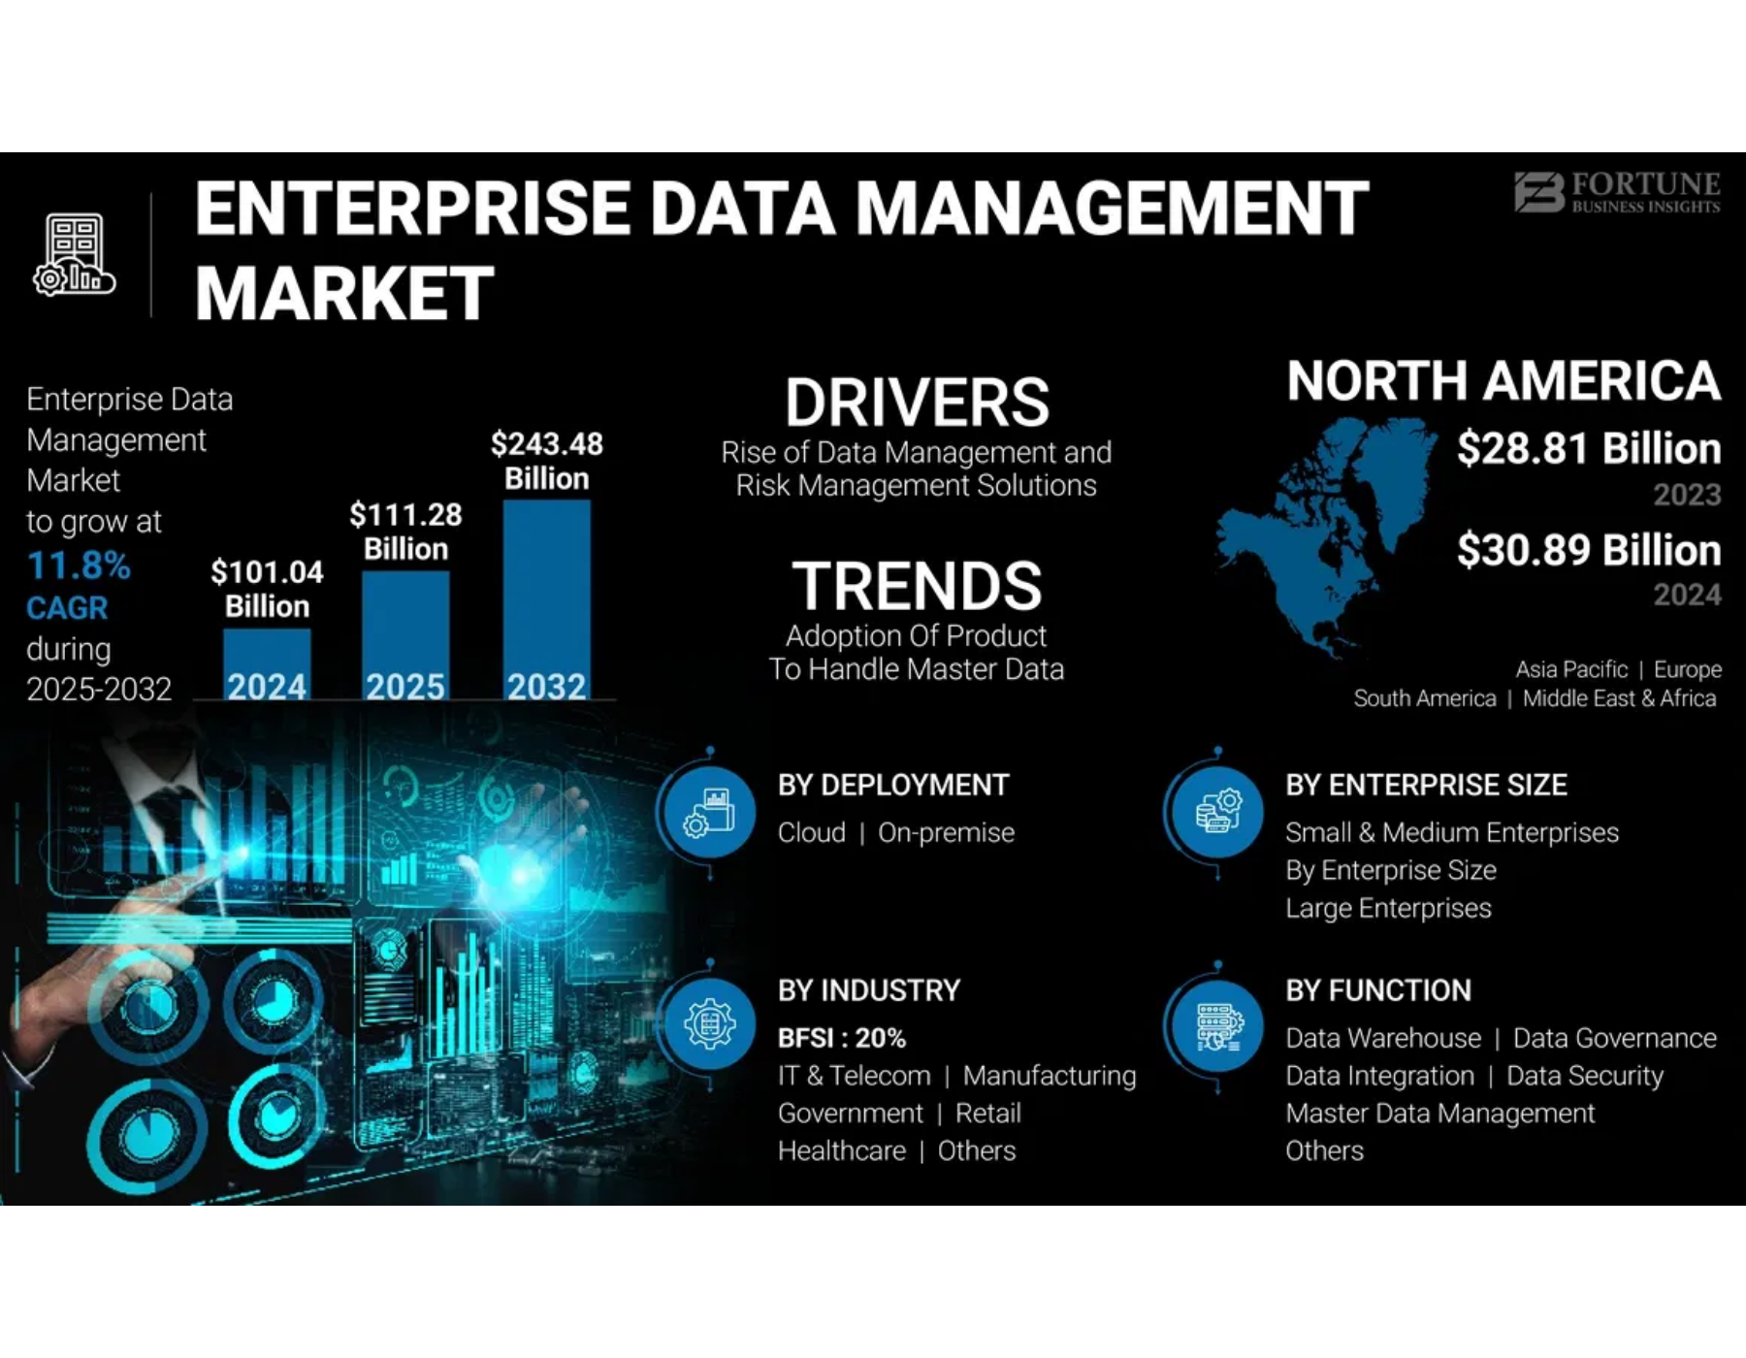
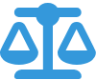






DLM Benefits and ROI
Process Improvement
Cost Control
Enhanced data quality
Optimized storage costs
Increased operational efficiency
Reduced data redundancy
Compliance
Risk Mitigation
Automated retention policies
Reduced data breach exposure
Simplified audit processes
Better disaster recovery
Measurable ROI Indicators
20-40% storage savings
30-50% time reduction
60% fewer incidents
Enterprise Data Management Market Growth and ROI
Data Lifecycle Management and Data Governance | Page 14

Slide 15
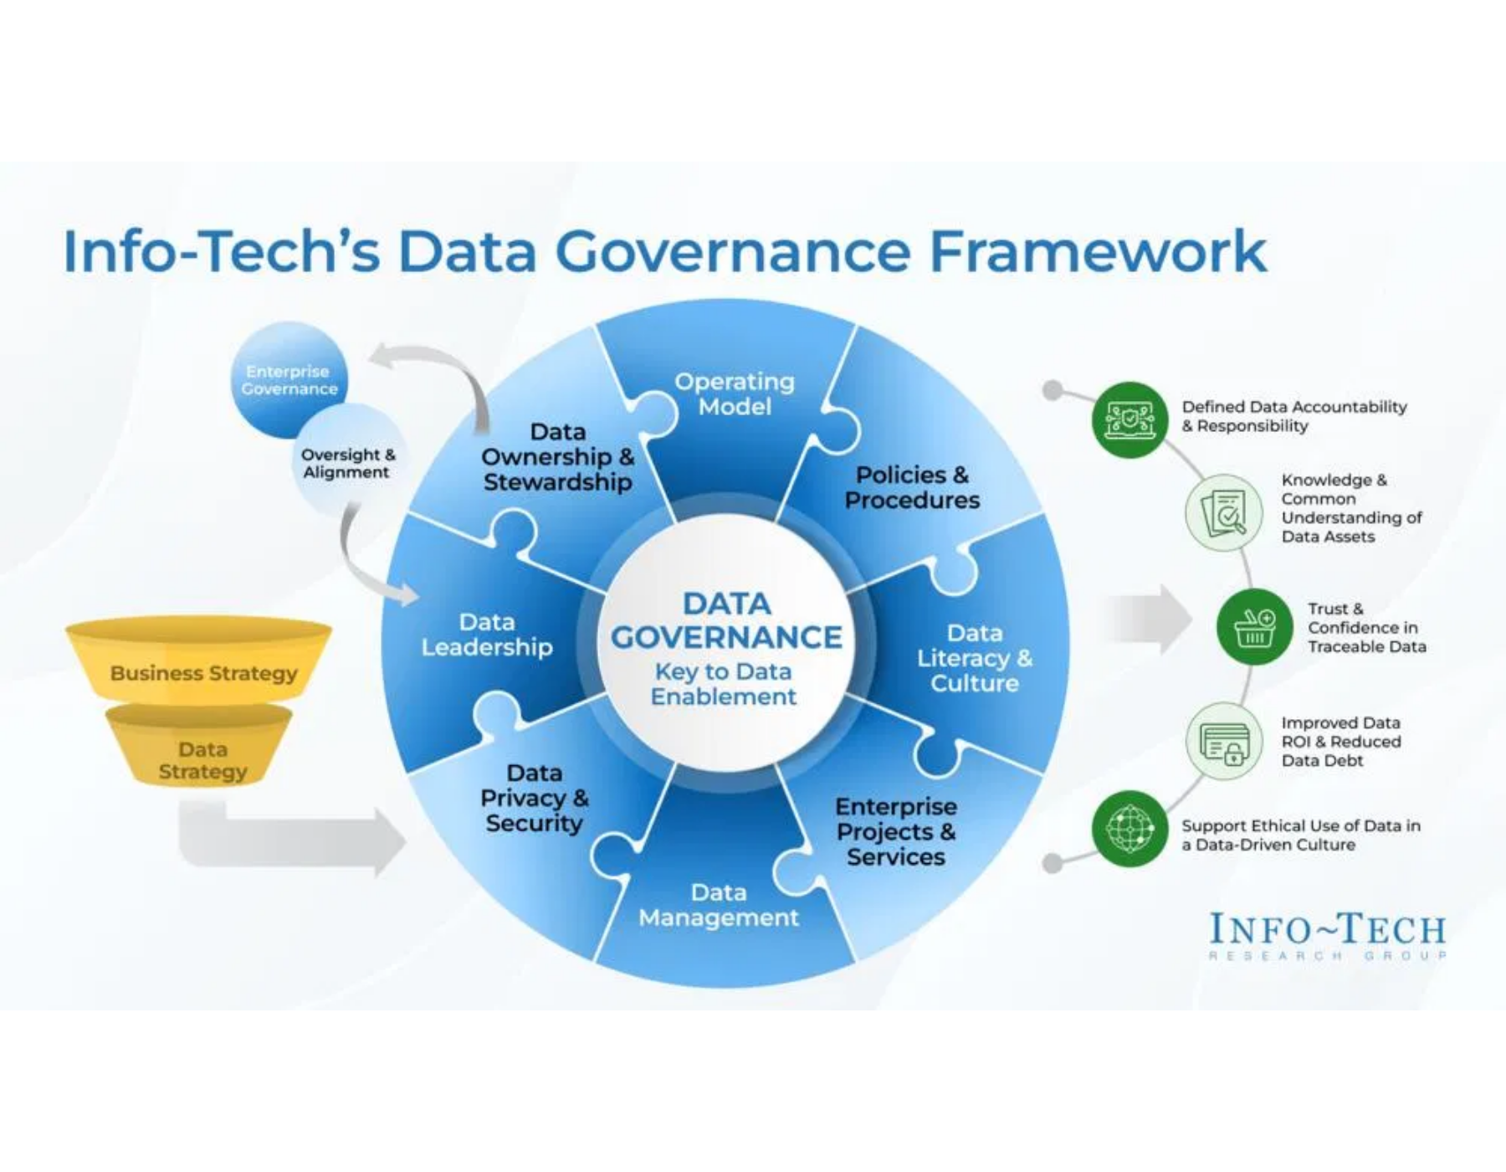





What is Data Governance?
Definition
Data Governance is a system that defines who within an organization has authority and control over data assets and how those data assets may be used. It establishes the framework for decision-making and accountability.
Scope
Framework
Enterprise-wide approach to managing data
Aligns strategy and objectives
Cross-functional collaboration
Policies, procedures, and standards
Key Components
Data Principles
Data Quality
Metadata
Data Access
Info-Tech Data Governance Framework
Data Lifecycle
Data Lifecycle Management and Data Governance | Page 15

Slide 16


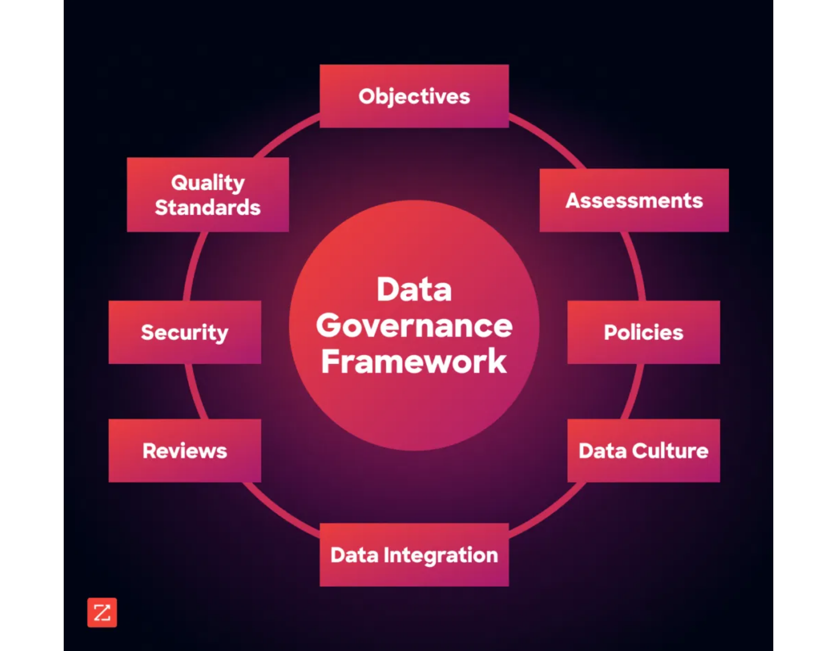


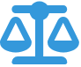

Data Governance Principles
Effective data governance is built on core principles that guide how organizations manage, protect, and leverage their data assets.
Integrity
Transparency
All participants act honestly about constraints, challenges, and impacts of data governance decisions.
Processes are clear and visible to both participants and auditors in implementation.
Accountability
Stewardship
Clearly defined responsibilities for data-related decisions, processes, and controls.
Assigned governance activities for both individual contributors and data stewardship groups.
Checks & Balances
Standardization
Controls between business and technology teams, creators and users of data.
Focus on introducing and supporting standardized enterprise data definitions and processes.
Data Governance Framework Components
Data Lifecycle Management and Data Governance | Page 16

Slide 17

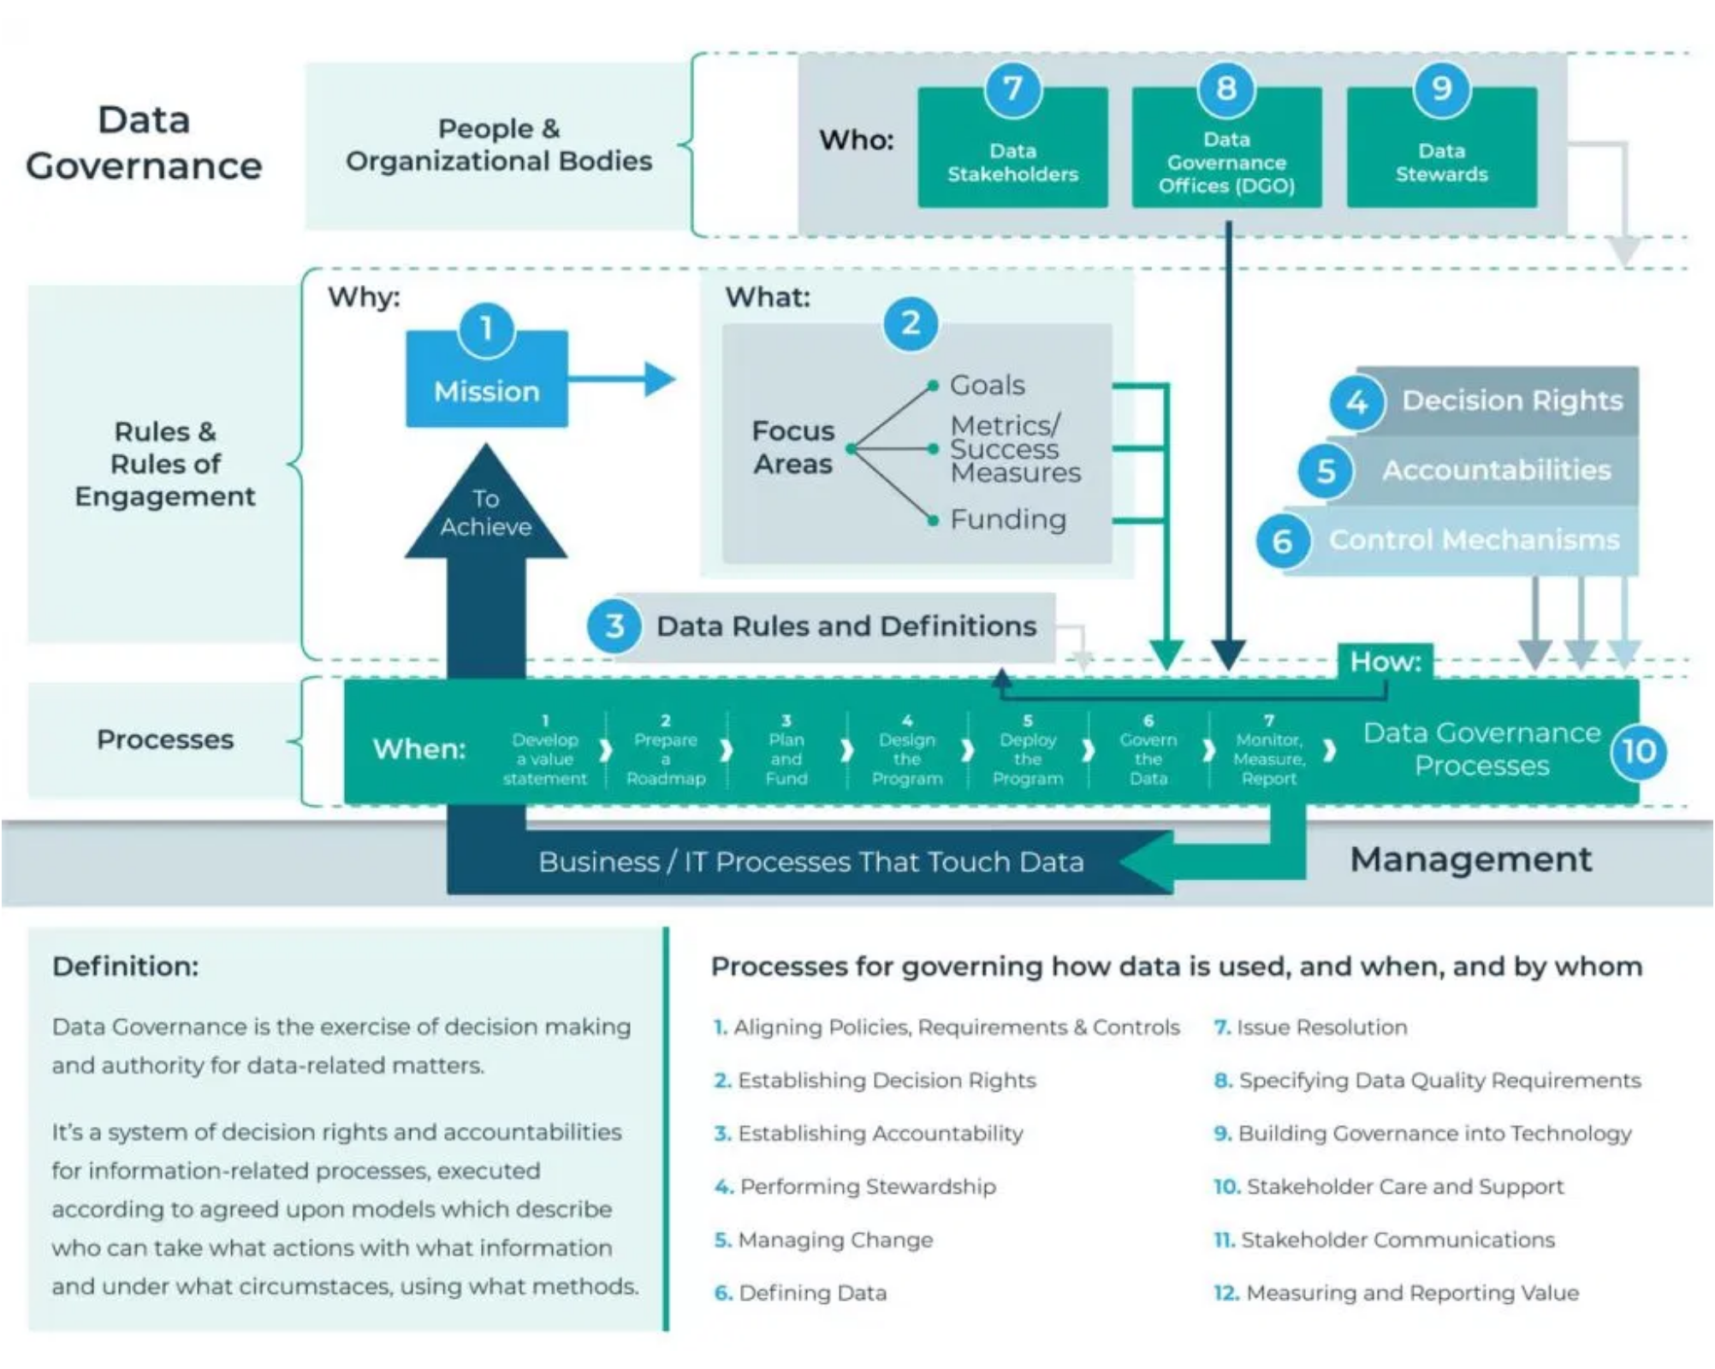




Data Governance Framework Components
Core Framework Elements
Decision Rights:
Clearly defined authority for data-related
decisions
Accountability:
Assigned responsibilities for data quality
and management
Policies & Procedures:
Documented standards for data
handling
Key Governance Domains
Data Policies:
Rules and guidelines for data usage
Data Security:
Protection measures and access controls
Data Governance Framework with Organizational Structure
Data Quality:
Standards for accuracy and completeness
Framework Implementation Approach
Metadata:
Documentation of data definitions and lineage
Start with high-priority data domains
Establish clear roles before implementing processes
Align with existing organizational structures
Data Lifecycle Management and Data Governance | Page 17

Slide 18



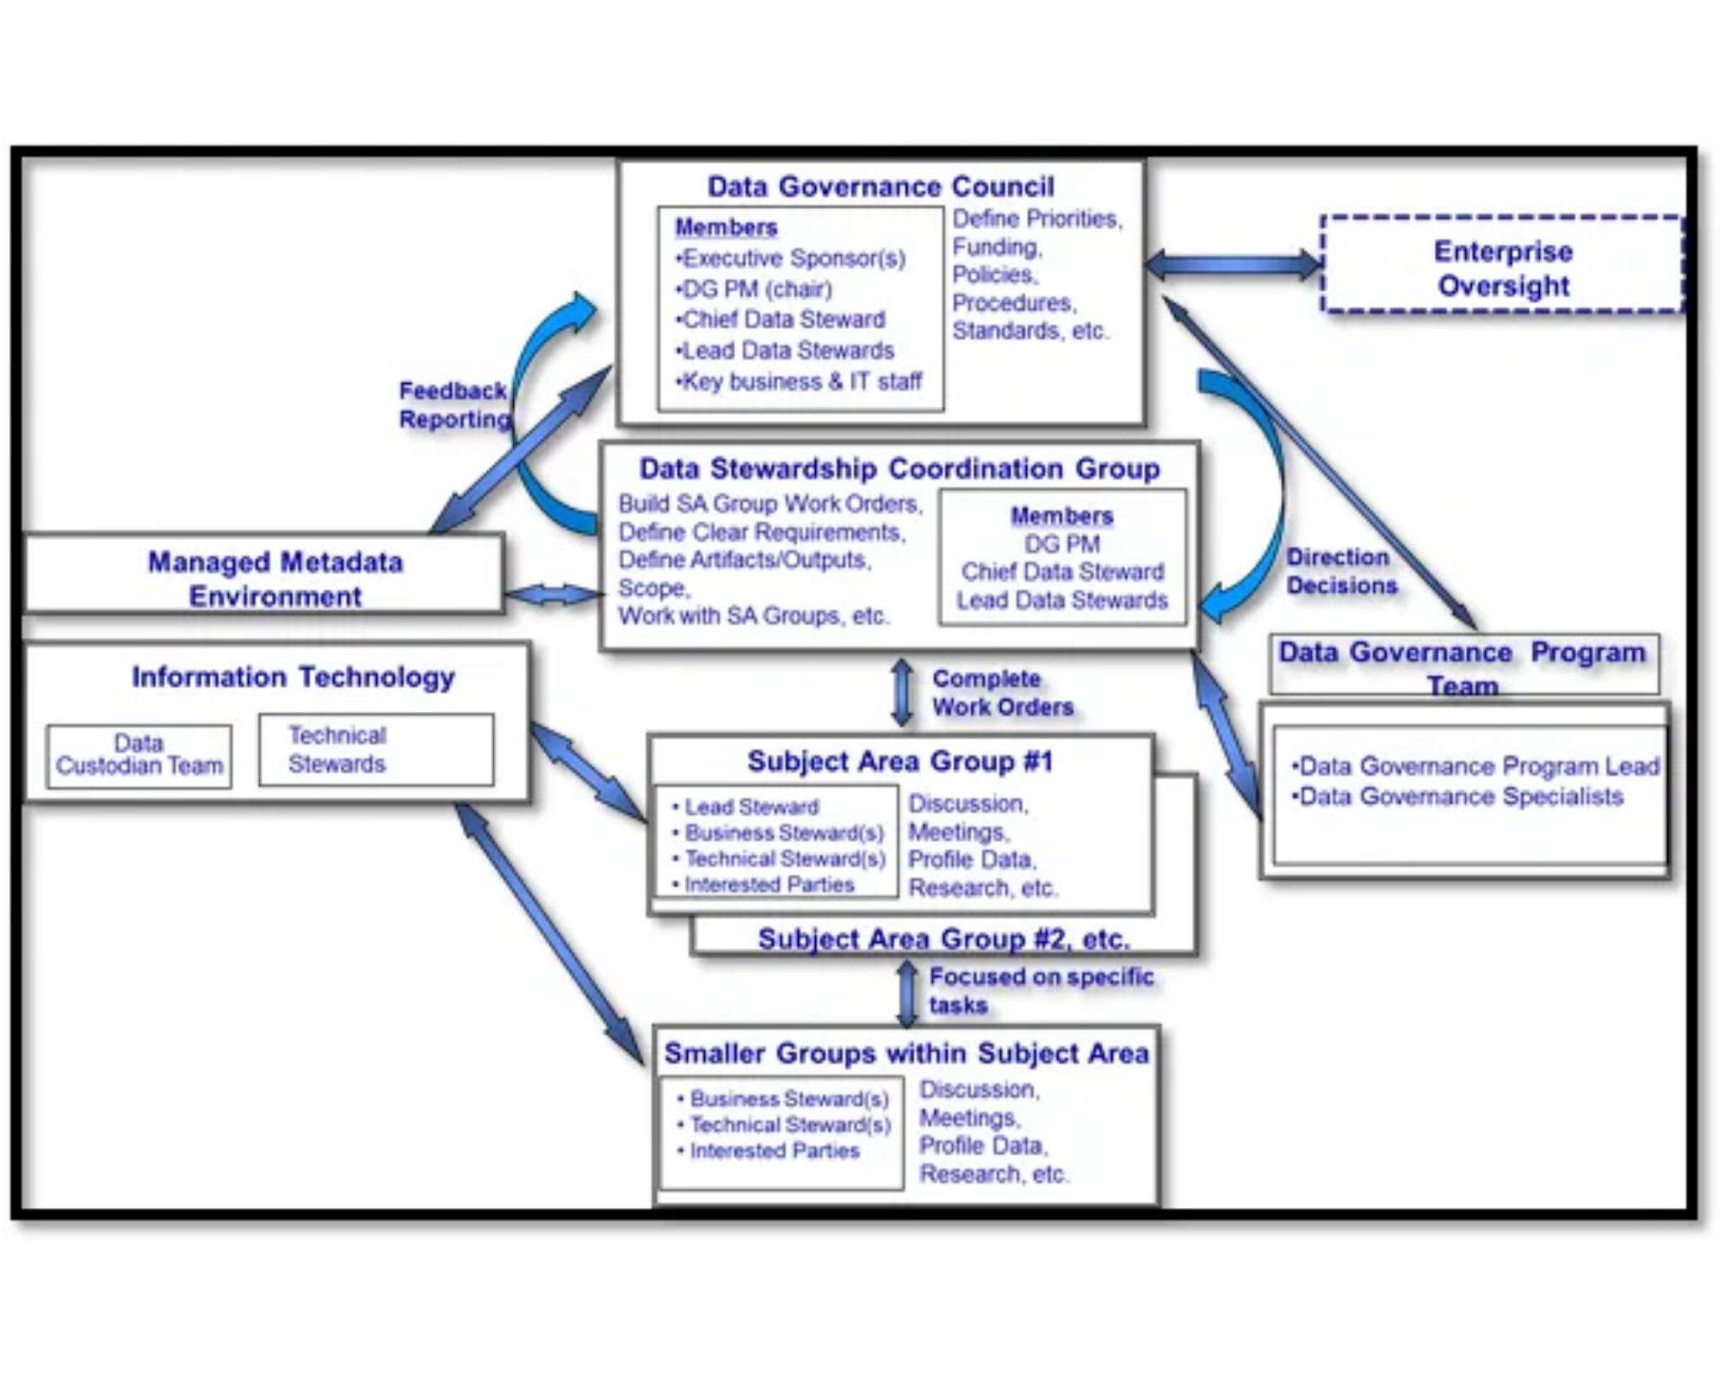




Data Governance Roles and Responsibilities
Key Governance Roles
Executive Sponsor
Provides strategic direction, secures resources, and champions data governance initiatives at the executive level.
Data Governance Council
Cross-functional leadership team that sets priorities, resolves escalated issues, and approves policies and standards.
Chief Data Officer (CDO)
Leads the data governance program, aligns data strategy with business objectives, and oversees implementation.
Data Stewards
Subject matter experts responsible for data quality, metadata, and business rules within their domain areas.
Data Custodians
IT professionals who implement and maintain the technical environment for data storage and access.
Organizational Structure Best Practices
Data Governance Organizational Structure and Reporting Lines
Effective governance requires clear reporting lines and decision-making authority. The structure should balance centralized oversight with distributed responsibility to ensure both enterprise standards and business unit flexibility.
Data Lifecycle Management and Data Governance | Page 18

Slide 19




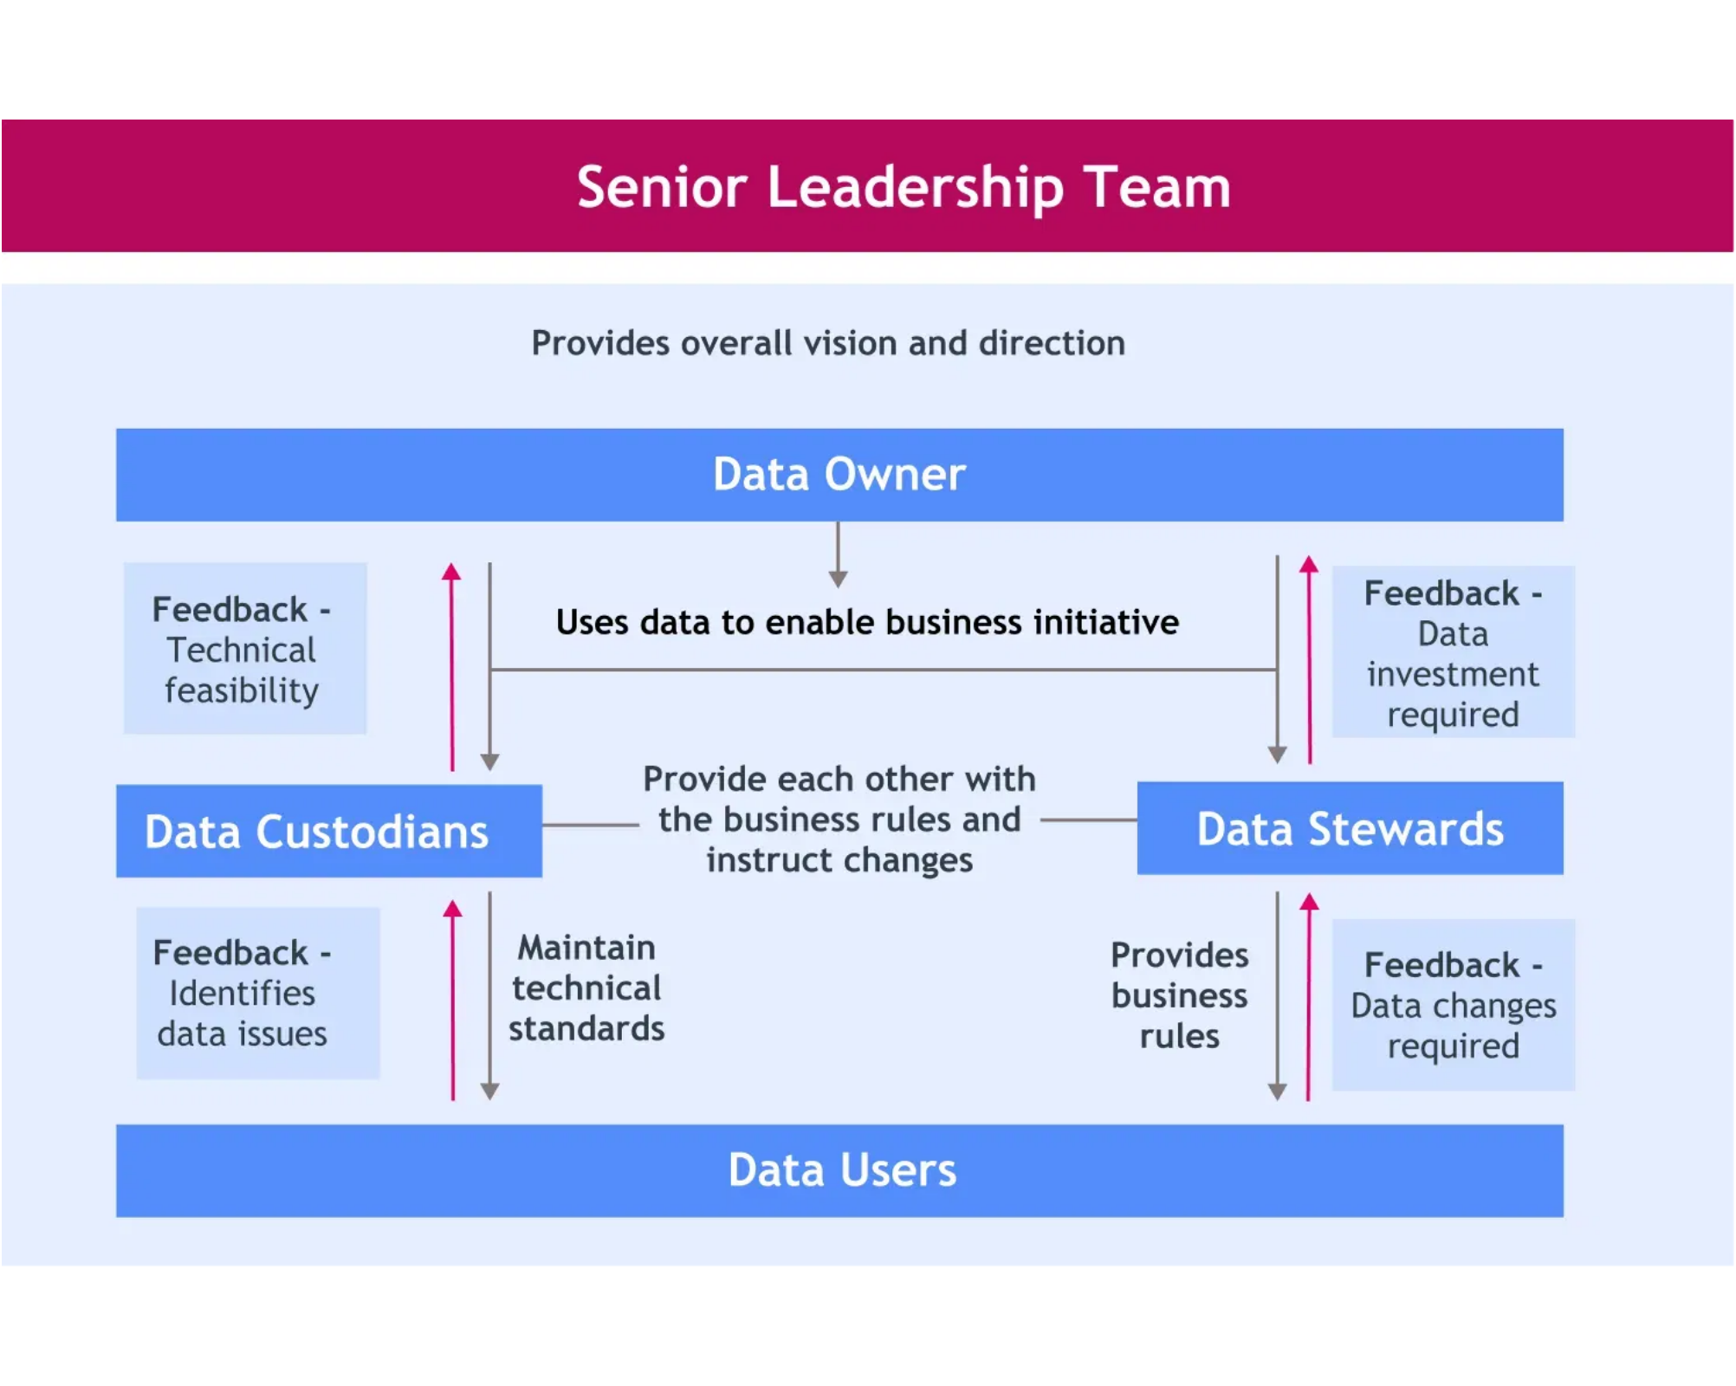





Data Governance Tools & Technologies
Essential Tool Categories
Metadata Management
Tools for documenting data definitions, lineage, and relationships
Data Quality Management
Solutions for profiling, cleansing, and monitoring data quality
Master Data Management (MDM)
Platforms for creating and maintaining a single source of truth
Data Security & Privacy
Tools for access control, encryption, and compliance monitoring
Key Features to Look For
Automated policy enforcement
Workflow management
Data lineage visualization
Integration capabilities
Reporting & dashboards
Scalability
Data Governance Roles and Supporting Tools
Implementation Considerations
Start with business-critical data domains
Ensure tools align with existing technology stack
Consider cloud vs. on-premises deployment options
Data Lifecycle Management and Data Governance | Page 18

Slide 20


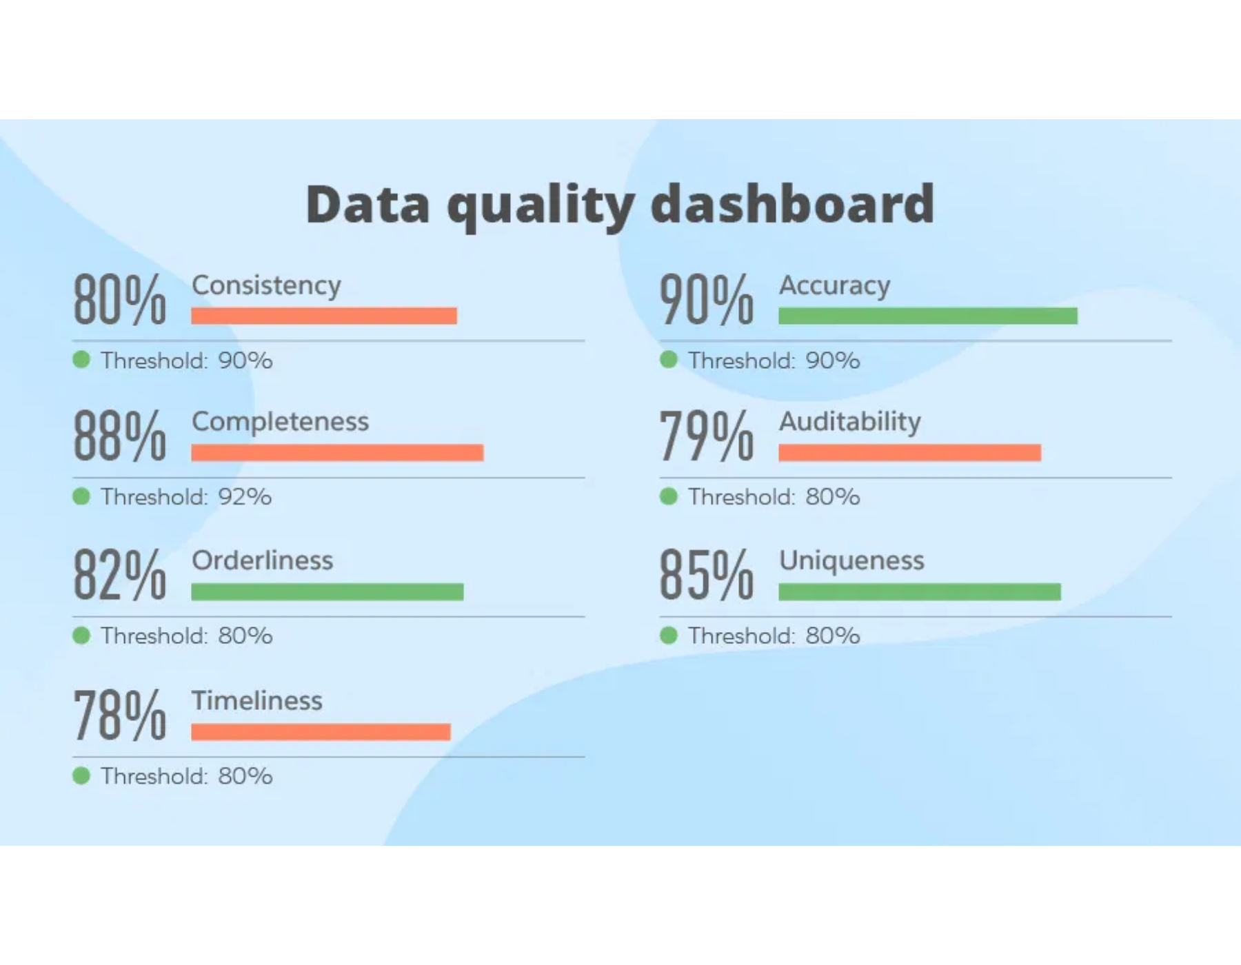











Data Quality Management
What is Data Quality?
The measure of how well data serves its intended purpose in a given context
Critical foundation for reliable analytics, decision-making, and operational efficiency
Key Dimensions of Data Quality
Accuracy
Completeness
Consistency
Timeliness
Uniqueness
Integrity
Quality Management Process
Profiling:
Assess current state of data quality
Cleansing:
Correct errors and standardize formats
Prevention:
Implement validation rules at entry points
Monitoring:
Continuously track quality metrics
Data Quality Metrics Dashboard Visualization
Implementation Best Practices
Define quality standards based on business requirements
Establish data quality SLAs with measurable metrics
Automate quality checks throughout the data lifecycle
Data Lifecycle Management and Data Governance | Page 19

Slide 21


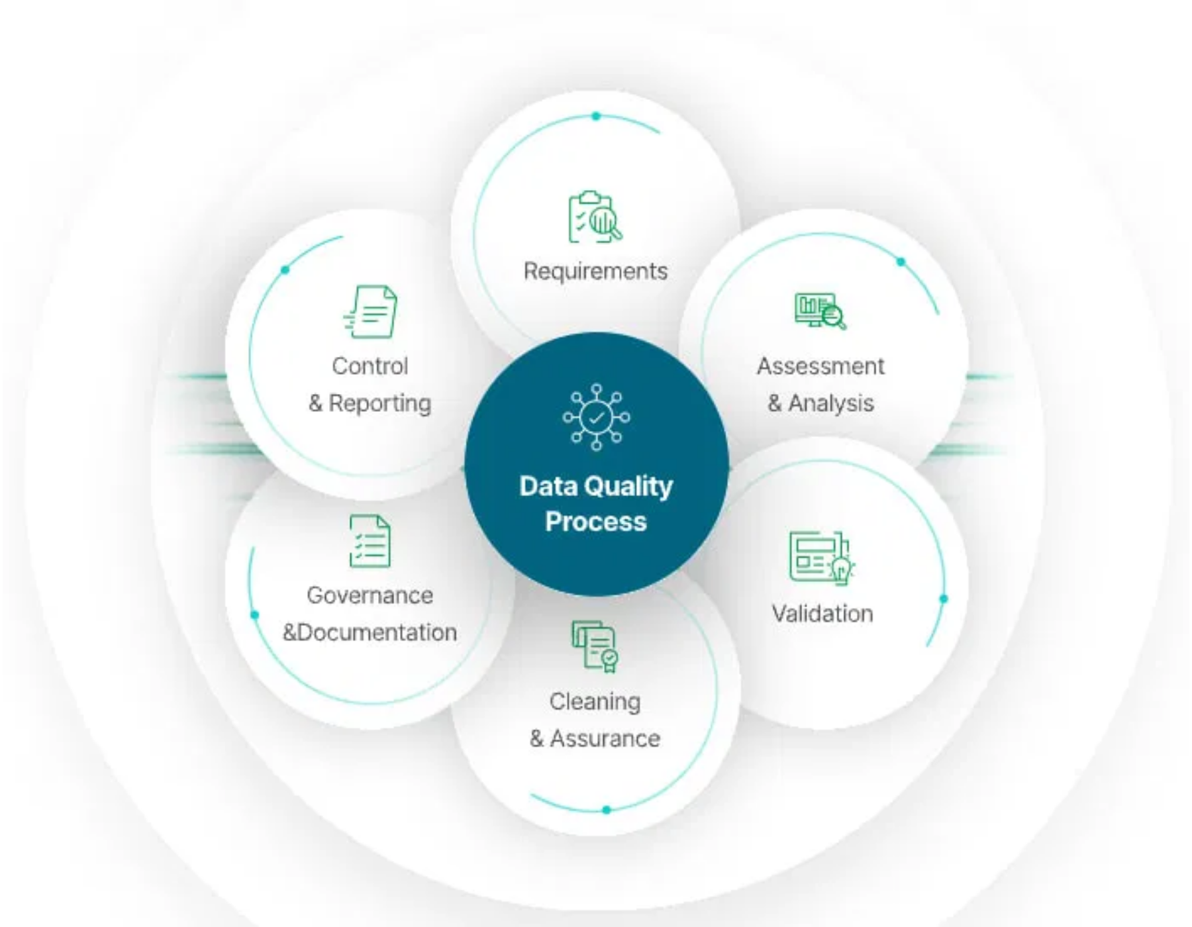










Data Security and Privacy
Security in Data Governance
Security is a foundational element of effective data governance
Protects data assets throughout the entire lifecycle
Key Security Controls
Access Management:
Role-based access controls (RBAC)
Encryption:
Data at rest, in transit, and in use
Audit Trails:
Monitoring and logging of data access
Data Masking:
Protecting sensitive information
Privacy Regulations
GDPR:
EU regulation with global impact
CCPA/CPRA:
California's consumer privacy laws
HIPAA:
Healthcare data protection
PCI DSS:
Payment card industry standards
Data Security and Privacy Best Practices Framework
Implementation Best Practices
Privacy by design approach
Regular security assessments
Data classification framework
Incident response planning
Data Lifecycle Management and Data Governance | Page 19

Slide 22

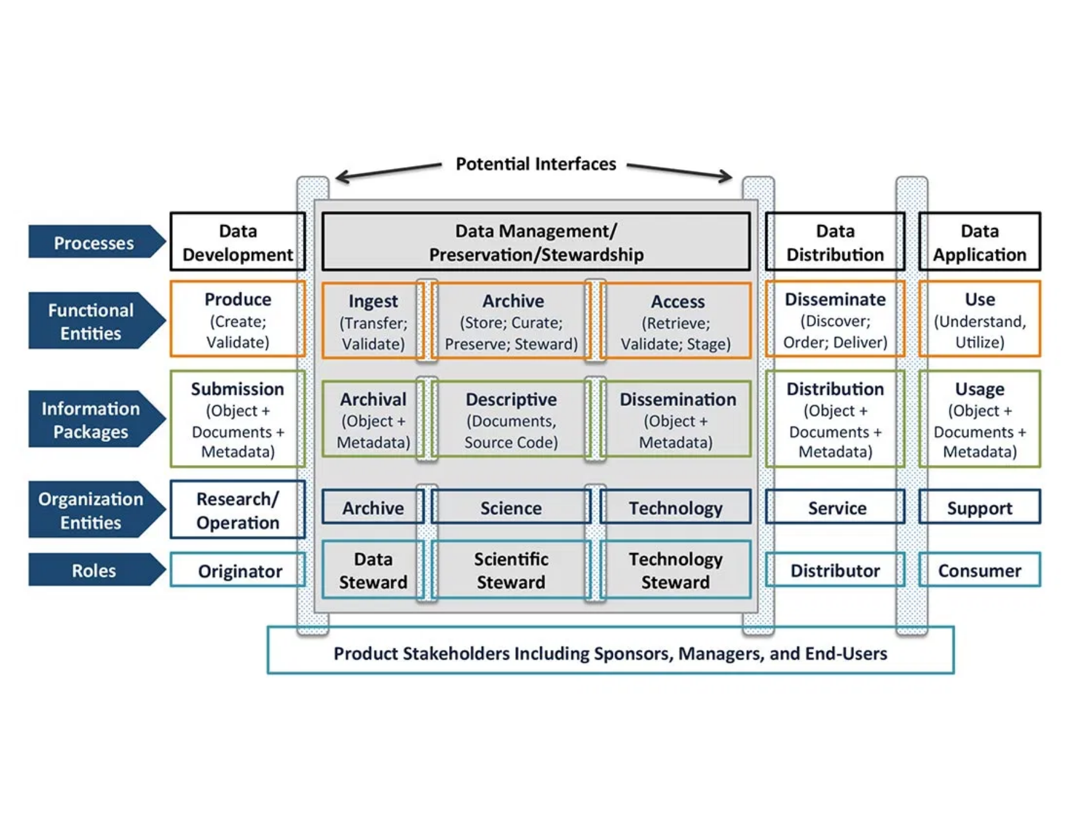








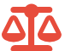


Metadata Management
What is Metadata?
Metadata is "data about data" that provides context, meaning, and organization to your information assets. It describes the structure, content, quality, condition, and other characteristics of data, enabling effective discovery, understanding, and management.
Types of Metadata
Business Metadata
Technical Metadata
Business context, definitions, ownership, policies, and rules that give data meaning from a business perspective.
Physical attributes like data types, formats, structures, and system information needed for technical operations.
Operational Metadata
Administrative Metadata
Information about data usage, processing history, access patterns, and lineage tracking.
Rights management, access permissions, retention schedules, and compliance requirements.
Benefits of Effective Metadata Management
Organizational Metadata Flow and Stewardship Model
Improved data discovery and accessibility
Enhanced data lineage and impact analysis
Better data quality and consistency
Streamlined regulatory compliance
Increased collaboration across teams
Accelerated analytics and insights
Data Lifecycle Management and Data Governance | Page 19

Slide 23


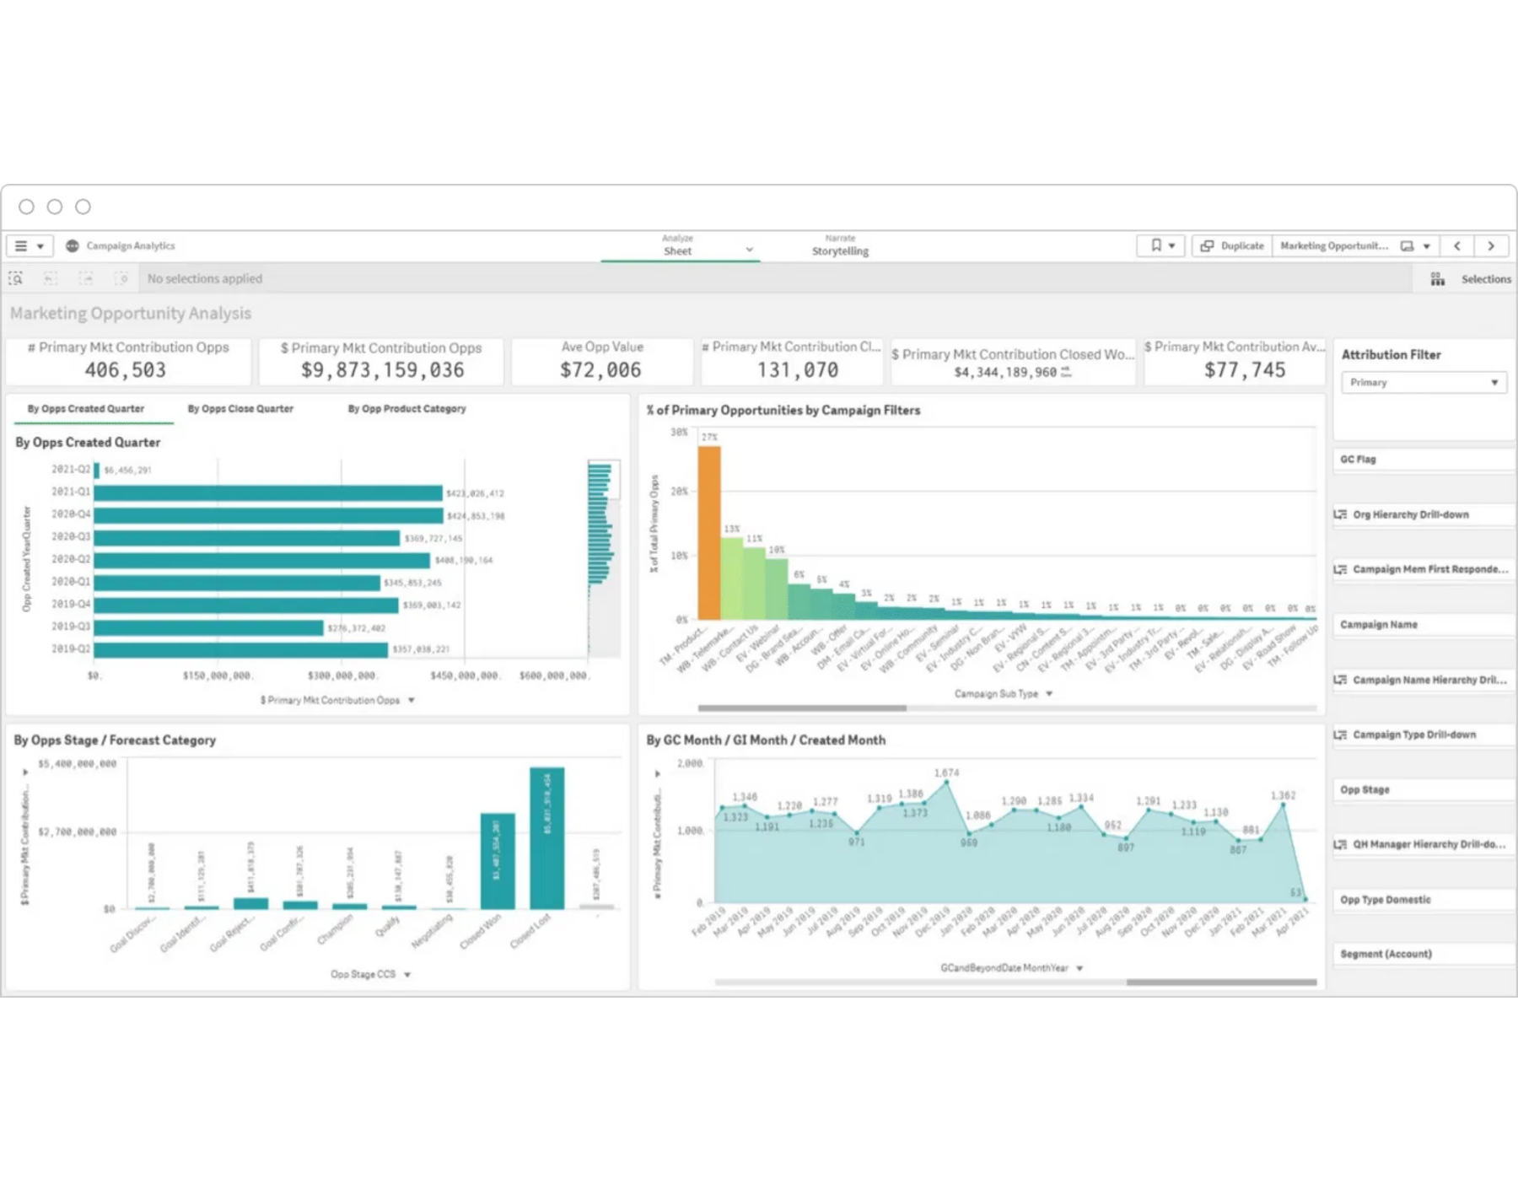
Data Governance Maturity Model
Maturity models provide a framework for assessing and improving data governance capabilities over time. They help organizations benchmark their current state and create a roadmap for advancement.
Maturity Progression
1
Initial / Ad Hoc
No formal governance, reactive approach to data issues, undefined processes, and limited awareness of data as an asset.
2
Repeatable / Developing
Basic governance processes defined for critical data, some roles established, but limited standardization across the organization.
3
Defined / Standardized
Formal governance structure with documented policies, consistent processes across departments, and established metrics.
4
Managed / Measured
Quantitative management of governance processes, proactive approach, integrated tools, and continuous improvement.
5
Optimized / Strategic
Data governance fully embedded in organizational culture, automated processes, predictive capabilities, and innovation-driven.
Data Governance Maturity Progression Visualization
Advancement Strategy
Progress through maturity levels requires executive sponsorship, dedicated resources, and incremental improvements. Focus on demonstrating value at each stage before advancing to build momentum and support.
Data Lifecycle Management and Data Governance | Page 19

Slide 24





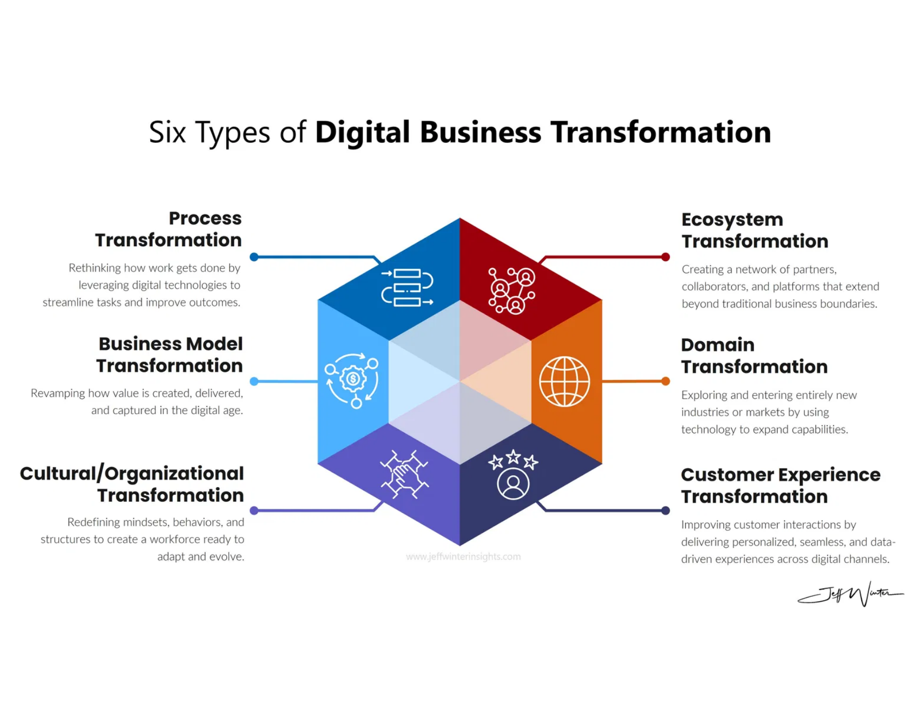


Data Governance Success Metrics
Measuring the effectiveness of data governance initiatives is essential to demonstrate value, secure continued support, and identify areas for improvement. A balanced set of metrics should span multiple dimensions.
Operational Metrics
Data Quality Metrics
% of data assets with assigned stewards
% of data meeting quality standards
Time to resolve data issues
Reduction in duplicate records
Governance council meeting frequency
Data validation error rates
Compliance Metrics
Business Value Metrics
% of sensitive data properly classified
Time saved in data discovery
Increased data reuse across projects
Audit findings remediation time
Policy violation incidents
Improved decision-making speed
Data Governance Metrics Dashboard Example
Metrics Implementation Tips
Start with a small set of high-impact metrics
Establish baselines before implementing changes
Automate metrics collection where possible
Data Lifecycle Management and Data Governance | Page 19

Slide 25






Integration: DLM and Data Governance
Bringing It All Together
Data Lifecycle Management and Data Governance are complementary frameworks that work best when integrated
DLM provides the operational processes while Governance establishes the strategic framework
Key Integration Points
Policies:
Governance defines,
Roles:
Shared responsibilities
Benefits of Integrated Approach
DLM implements
across both
Eliminates silos between strategic and operational data management
Processes:
Governance guides,
Tools:
Common platforms serving
Ensures consistent application of policies throughout data lifecycle
DLM executes
both needs
Creates clear accountability from creation to deletion
Metrics:
Shared KPIs and success
Security:
Consistent controls
measures
throughout lifecycle
Maximizes return on data investments through coordinated approach
Integration Framework for Data Management Initiatives
Data Lifecycle Management and Data Governance | Page 20

Slide 26


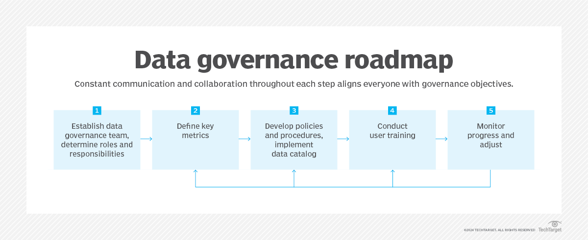







Implementation Roadmap
Implementation Phases
Assessment & Planning:
Evaluate current state, identify gaps, and define
objectives
Foundation Building:
Establish governance structure, roles, and initial
policies
Pilot Implementation:
Start with high-value data domains and demonstrate
quick wins
Expansion & Integration:
Scale across the organization and integrate with
processes
Continuous Improvement:
Measure, refine, and evolve the program
Common Implementation Challenges
Securing sustained executive sponsorship
Balancing centralized control with business unit flexibility
Overcoming resistance to change and cultural barriers
Demonstrating tangible ROI and business value
Critical Success Factors
Data Governance Implementation Roadmap
Align governance with business objectives and strategy
Focus on people and culture as much as technology
Communicate value and celebrate successes
Start small, demonstrate value, then scale
Data Lifecycle Management and Data Governance | Page 20

Slide 27

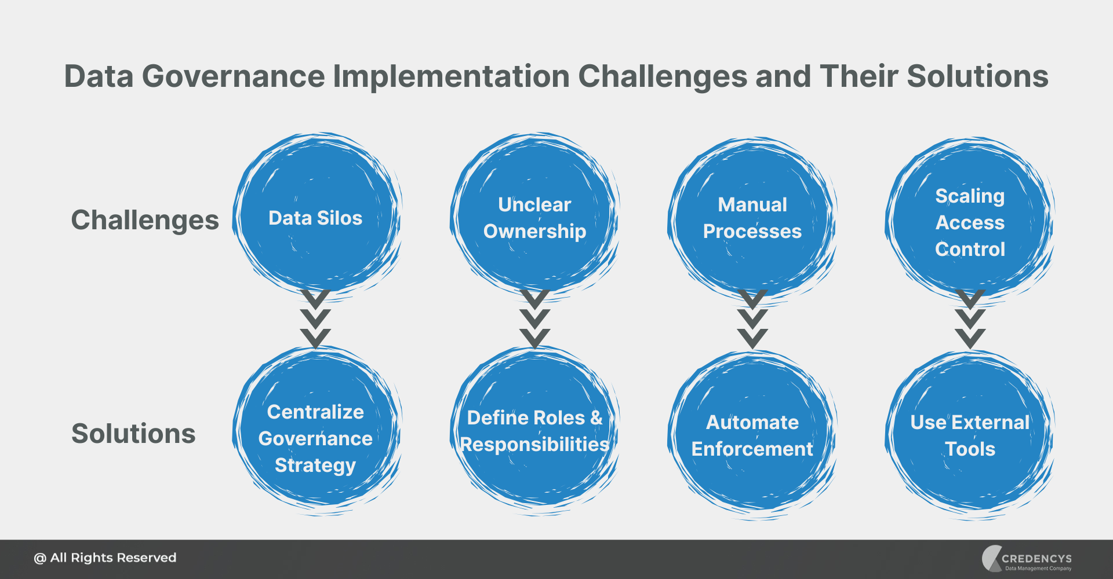
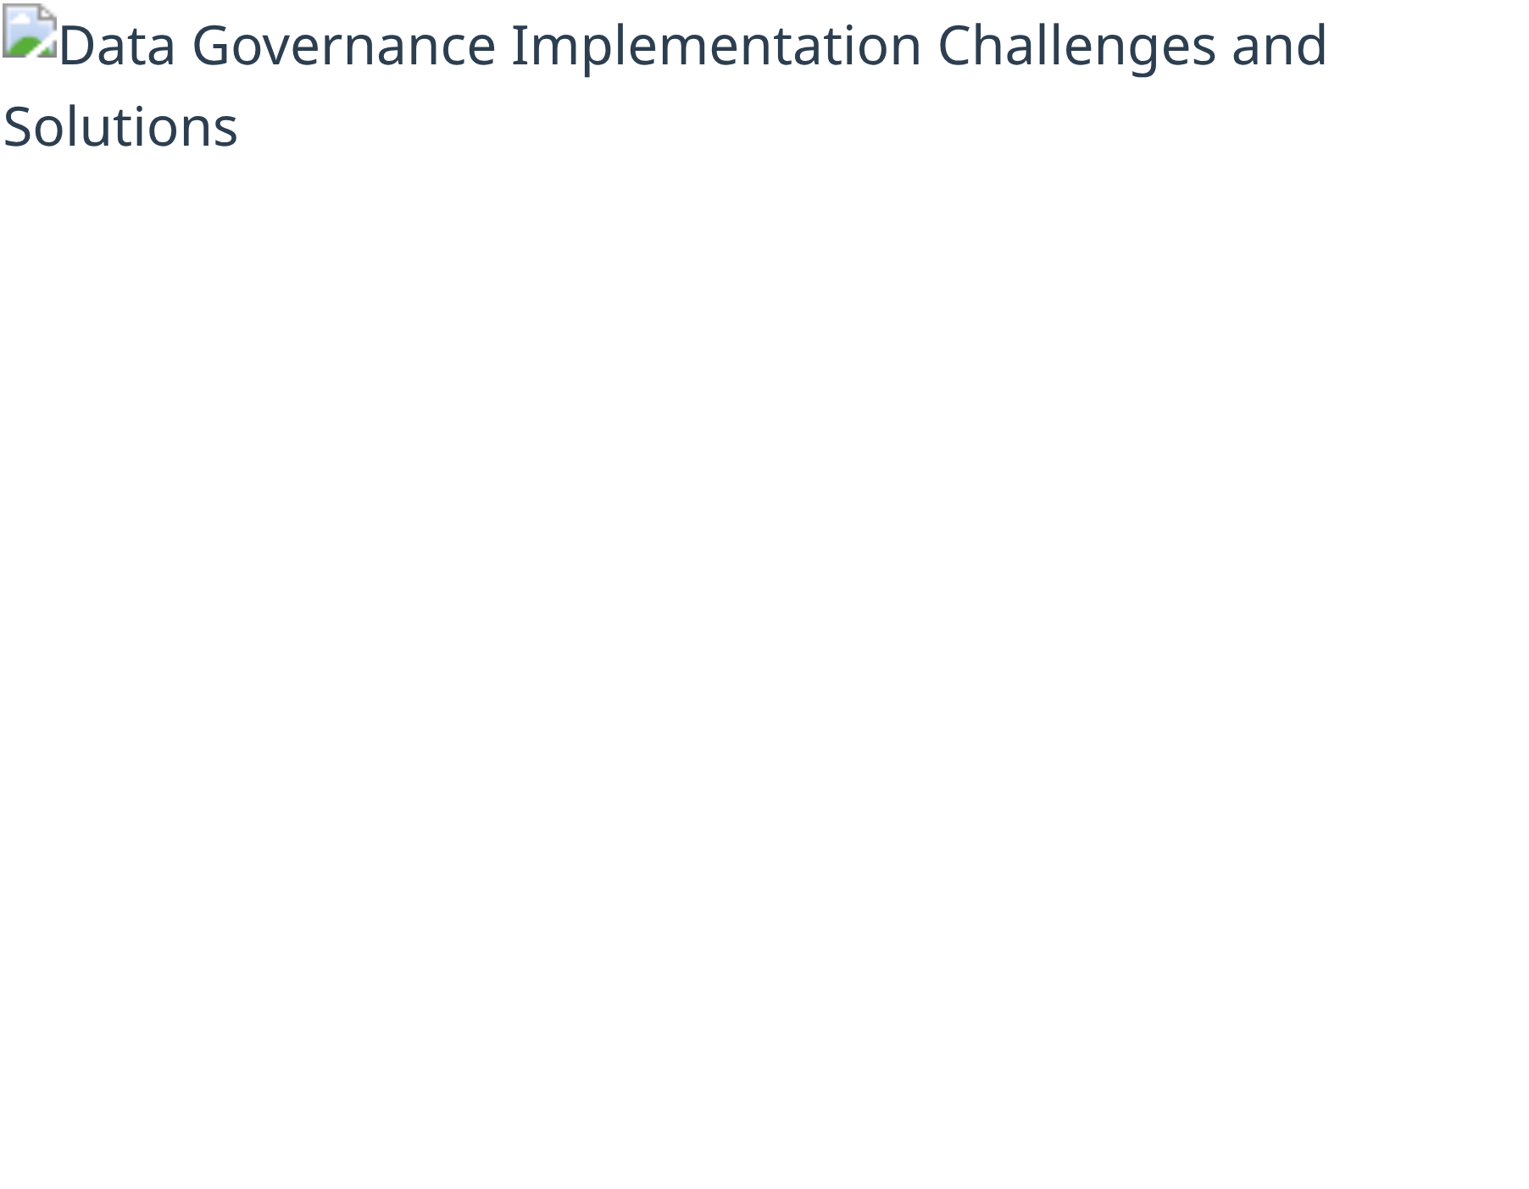


Implementation Challenges and Solutions
Despite the clear benefits, implementing effective data lifecycle management and governance faces significant challenges. Understanding these obstacles and having strategies to overcome them is essential for success.
Common Implementation Challenges
Data Silos:
Disconnected systems
Legacy Systems:
Outdated
and departments
technology constraints
Resistance to Change:
Cultural
Resource Constraints:
Budget
barriers
and staffing
Skill Gaps:
Lack of data expertise
Scope Creep:
Trying to do too
much at once
Practical Solutions and Best Practices
Start Small:
Begin with high-value, manageable data domains
Executive Sponsorship:
Secure leadership support and visibility
Data Governance Implementation Roadmap with Challenge Mitigation
Change Management:
Focus on communication and training
Demonstrate Value:
Show quick wins and business impact
Phased Approach:
Implement incrementally with clear milestones
Automation:
Use tools to reduce manual effort and increase adoption
Data Lifecycle Management and Data Governance | Page 20

Slide 28



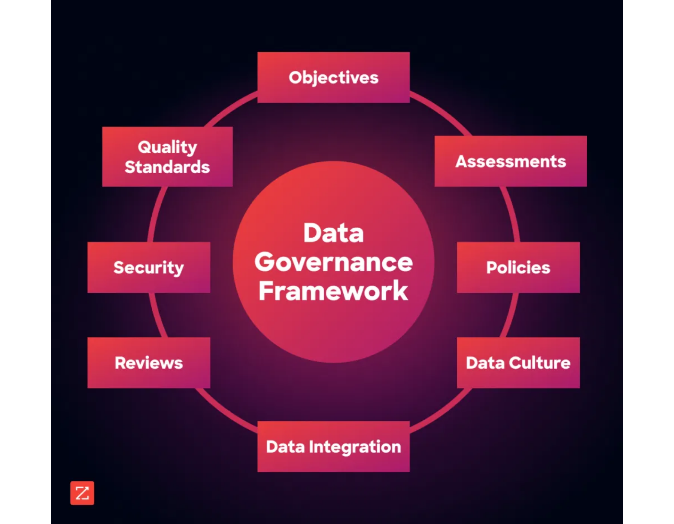

Resources and References
Recommended Reading
"Data Governance: How to Design, Deploy, and Sustain an Effective
Program"
by John Ladley
"DAMA-DMBOK: Data Management Body of Knowledge"
by DAMA
International
"Non-Invasive Data Governance"
by Robert S. Seiner
"Data Strategy: How to Profit from a World of Big Data, Analytics and
Artificial Intelligence"
by Bernard Marr
Industry Standards and Frameworks
DAMA-DMBOK Framework
ISO/IEC 38500 (IT Governance)
COBIT (Control Objectives for IT)
TOGAF (Enterprise Architecture)
CMMI Data Management Maturity
IBM Data Governance Council Maturity Model
Professional Communities and Resources
DAMA International (Data Management Association) - dama.org
Data Governance Framework Components and Resources
EDM Council (Enterprise Data Management Council) - edmcouncil.org
Data Governance Professionals Organization - datagovernanceprofessionals.org
The Data Management Association - tdwi.org
Data Lifecycle Management and Data Governance | Page 22

Slide 29



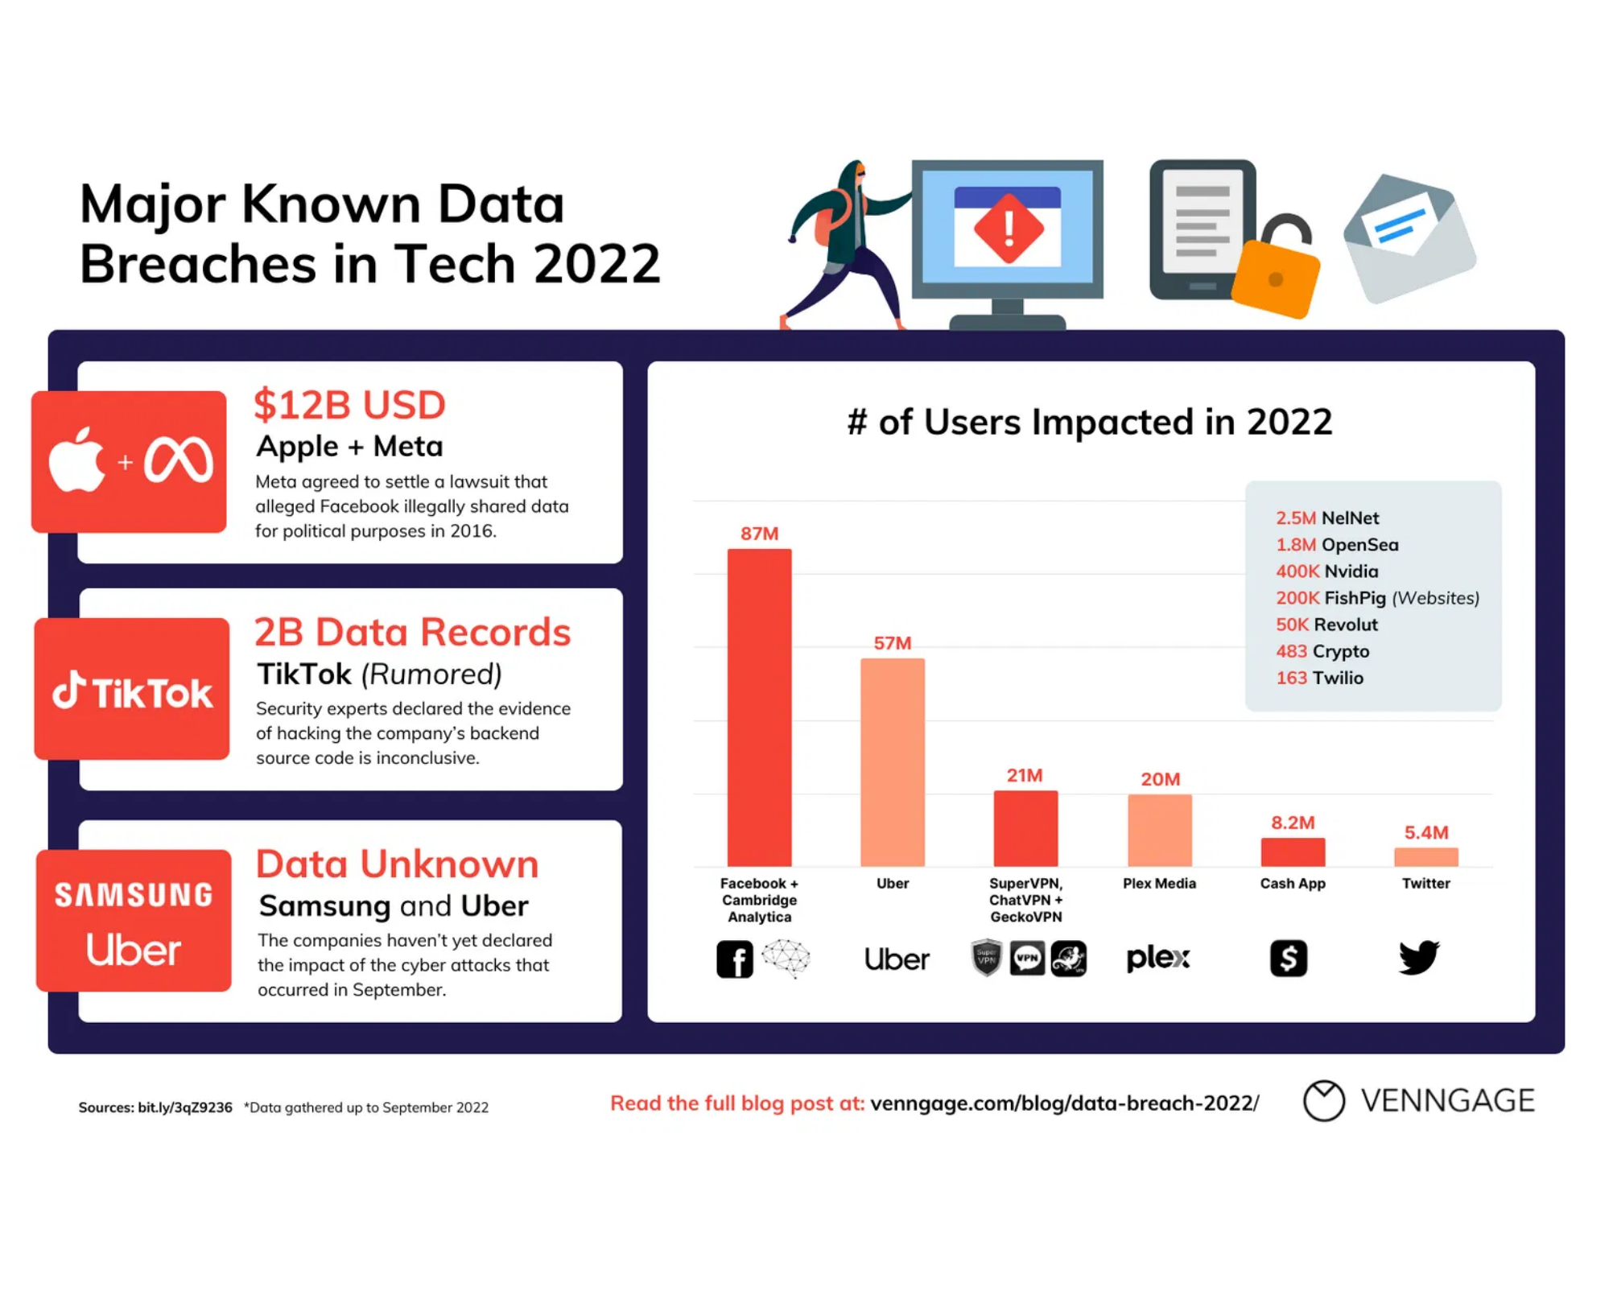

Why Data Privacy Matters
Growing Digital Footprint
Average person generates 1.7MB of data every second
2.5 quintillion bytes of data created daily worldwide
Business Risks
Financial penalties: Up to 4% of global annual revenue under GDPR
Average data breach cost: $4.45 million in 2023
Consumer Awareness
79% of consumers are concerned about how companies use their data, and 64% have declined to use a product or service due to data privacy concerns.
Major Data Breaches and Their Impact (Source: Venngage, 2023)
Global Data Privacy Regulations: A Comprehensive Overview
2

Slide 30


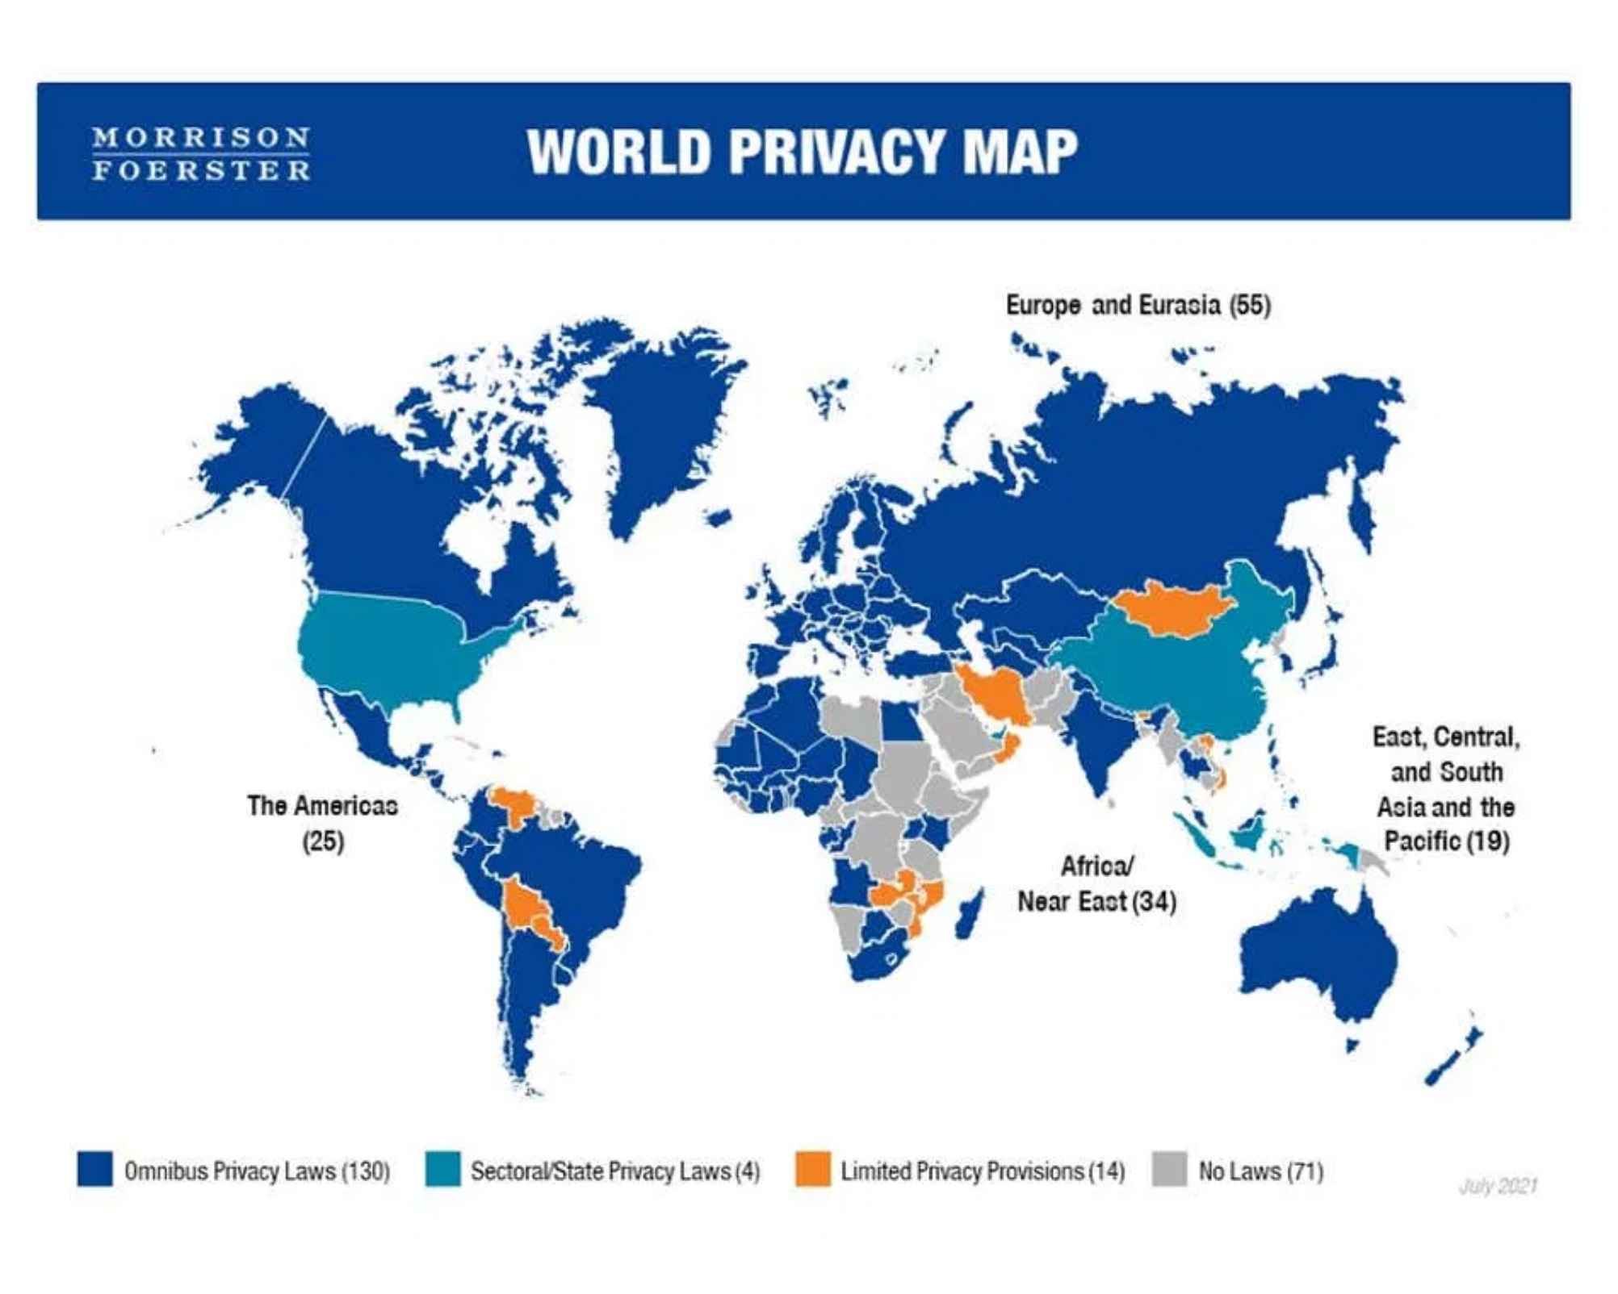

The Global Privacy Regulatory Landscape
Global Coverage
79% of countries have enacted data protection laws
Trend toward comprehensive vs. sectoral regulation
Key Privacy Legislation Timeline
1970s
1995
2018
2020-23
2024+
First Privacy Laws
EU Data Protection Directive
GDPR Enforcement
Global Adoption Wave
AI Regulation
Regional Coverage
Europe: 94% of countries with comprehensive laws
Asia-Pacific: 65% with varying approaches
Americas: 71% with mix of comprehensive and sectoral
Africa: 61% with increasing adoption
World Privacy Map (Source: Morrison Foerster, 2024)
Global Data Privacy Regulations: A Comprehensive Overview
3

Slide 31


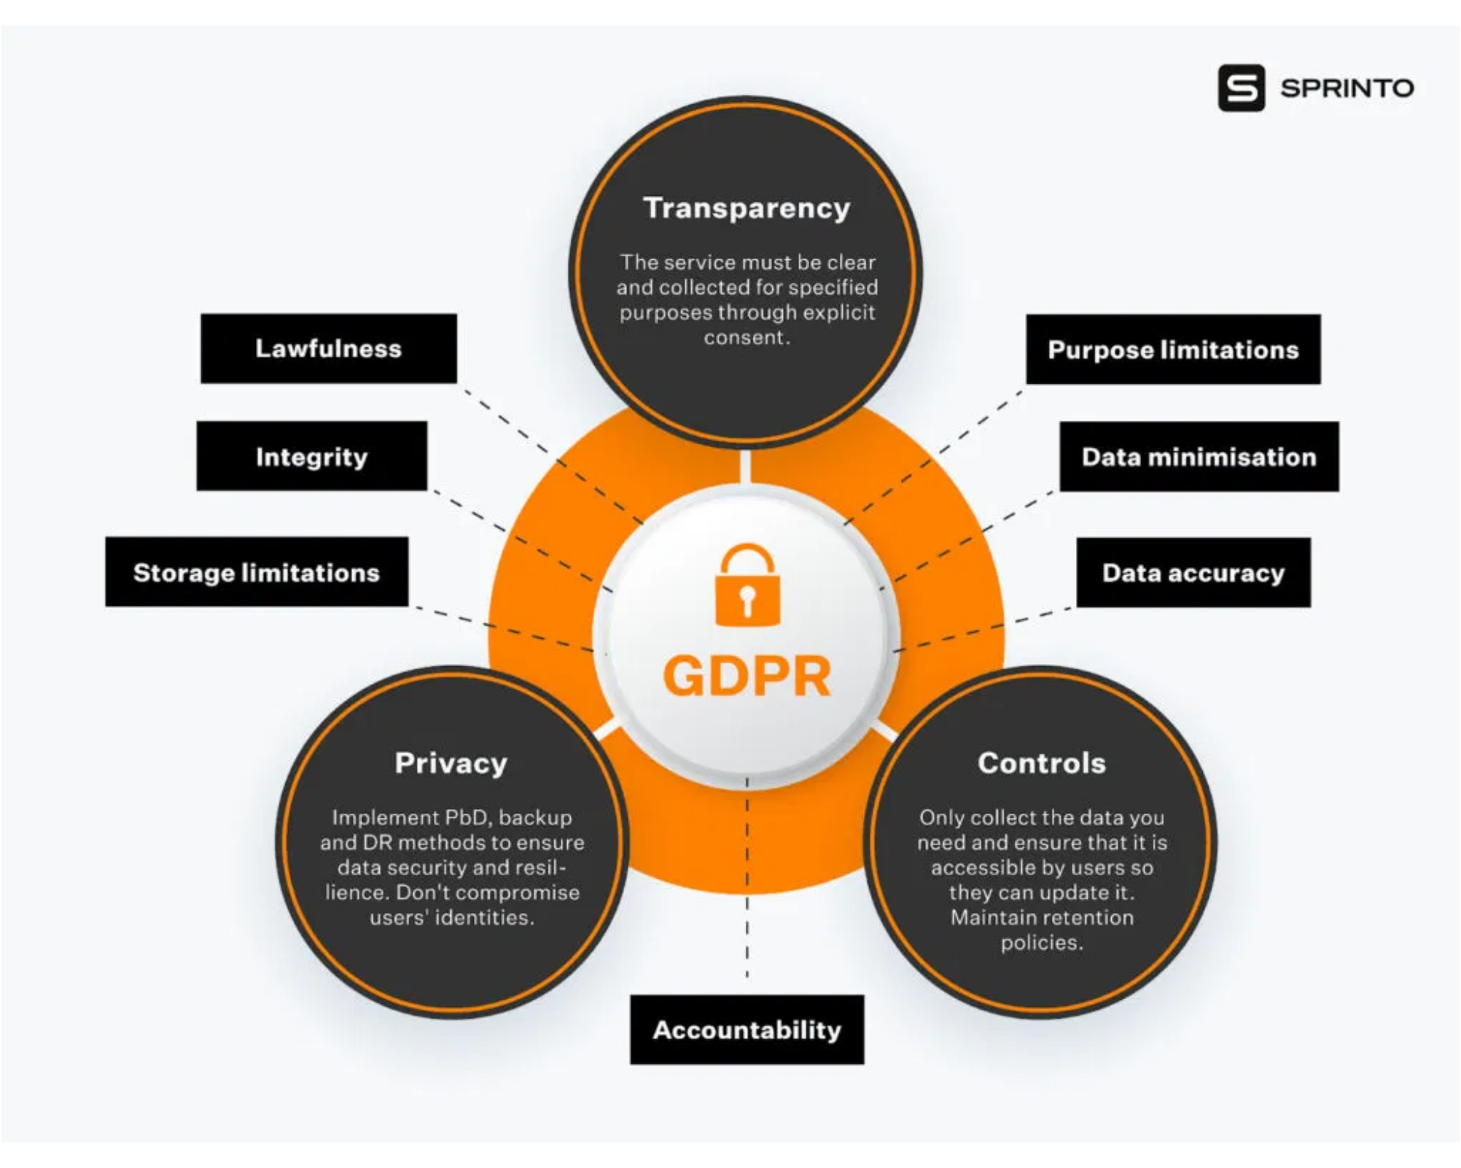




GDPR: Europe's Comprehensive Data Protection Framework
Scope & Applicability
Effective May 25, 2018 - most rigorous privacy law globally
Extraterritorial scope: applies to EU residents' data worldwide
Key Principles
Lawfulness
Fairness
Transparency
Purpose Limitation
Data Minimization
Accuracy
Data Subject Rights
Access, rectification, erasure, portability, objection
Right to be informed and restrict processing
Penalties & Enforcement
GDPR Compliance Framework (Source: Sprinto, 2024)
Up to €20 million or 4% of global annual revenue, whichever is higher. Over €4 billion in fines issued since 2018.
Global Data Privacy Regulations: A Comprehensive Overview
4

Slide 32


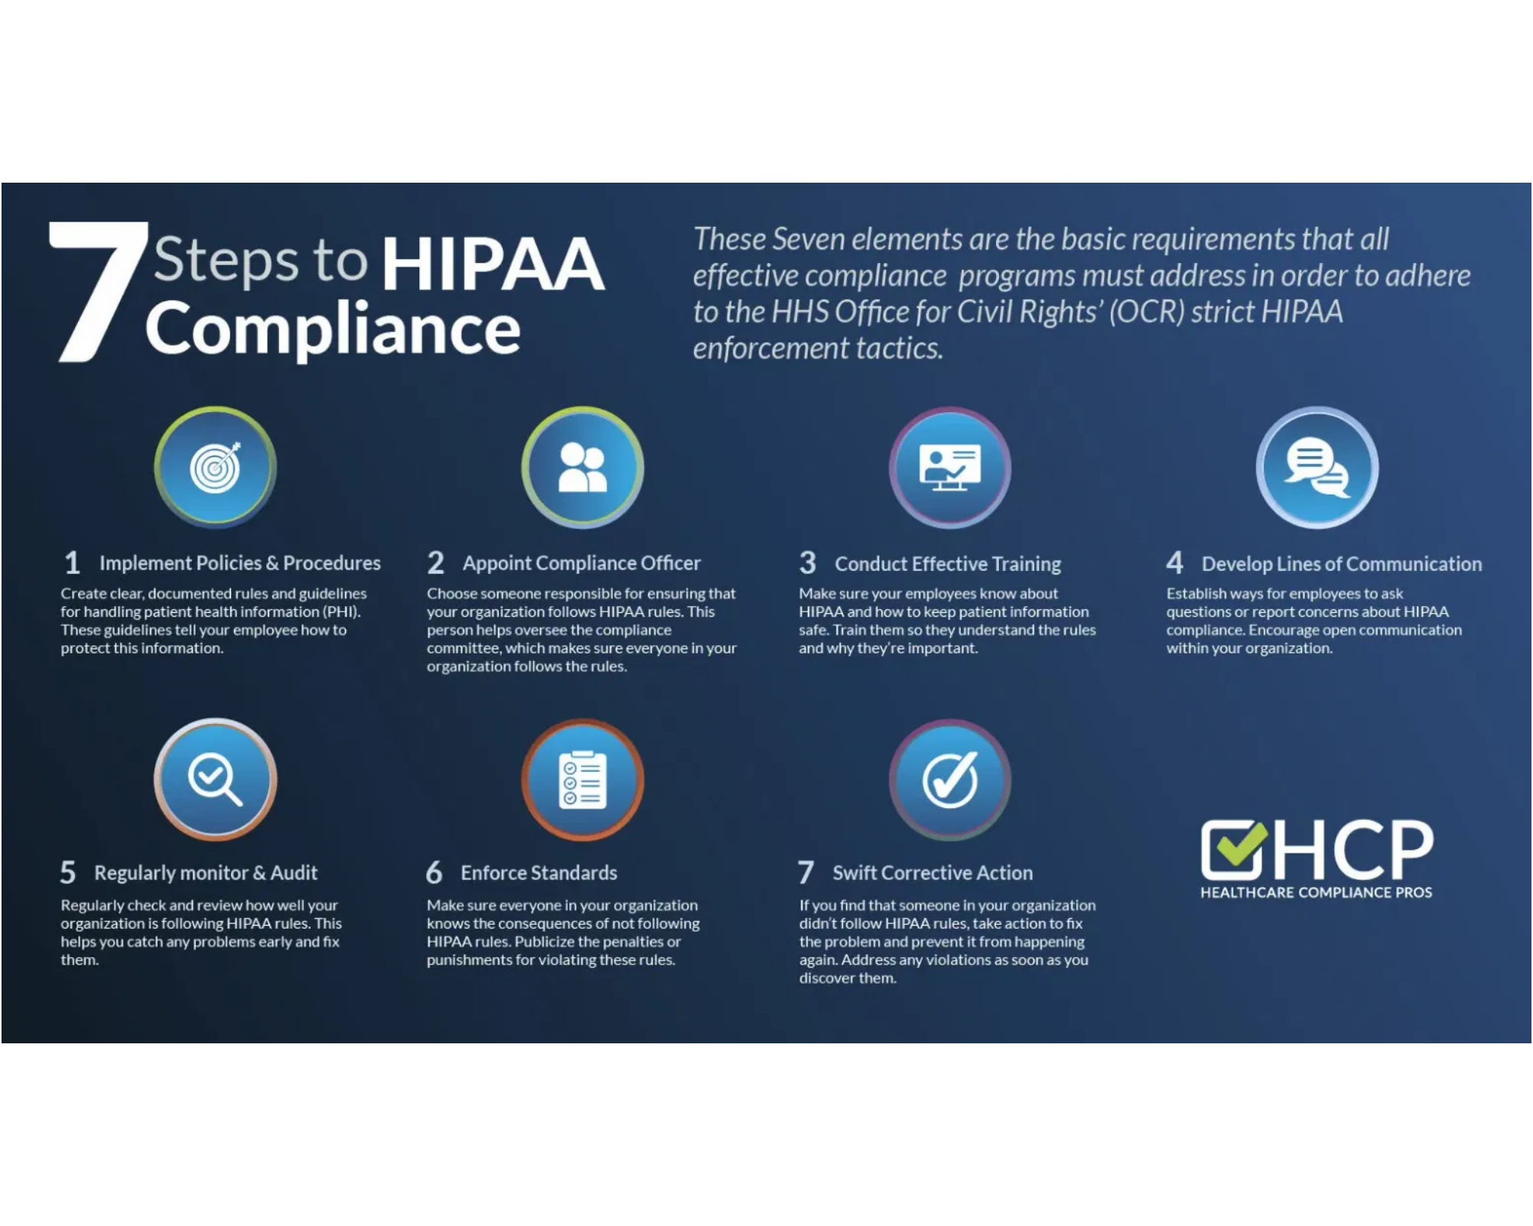

HIPAA: Protecting Health Information in the US
Overview & Scope
Health Insurance Portability and Accountability Act (1996)
Protects Protected Health Information (PHI)
Covered Entities
Healthcare providers, health plans, healthcare clearinghouses
Business associates handling PHI on behalf of covered entities
Privacy Rule (2003)
Security Rule (2005)
Governs use and disclosure of PHI, patient rights, and consent requirements
Sets standards for electronic PHI (ePHI) with administrative, physical, and technical safeguards
Enforcement & Penalties
Enforced by HHS Office for Civil Rights
7 Steps to HIPAA Compliance (Source: Healthcare Compliance Pros, 2024)
Tiered civil penalties up to $1.9M per violation category
Criminal penalties for willful violations
Global Data Privacy Regulations: A Comprehensive Overview
5

Slide 33


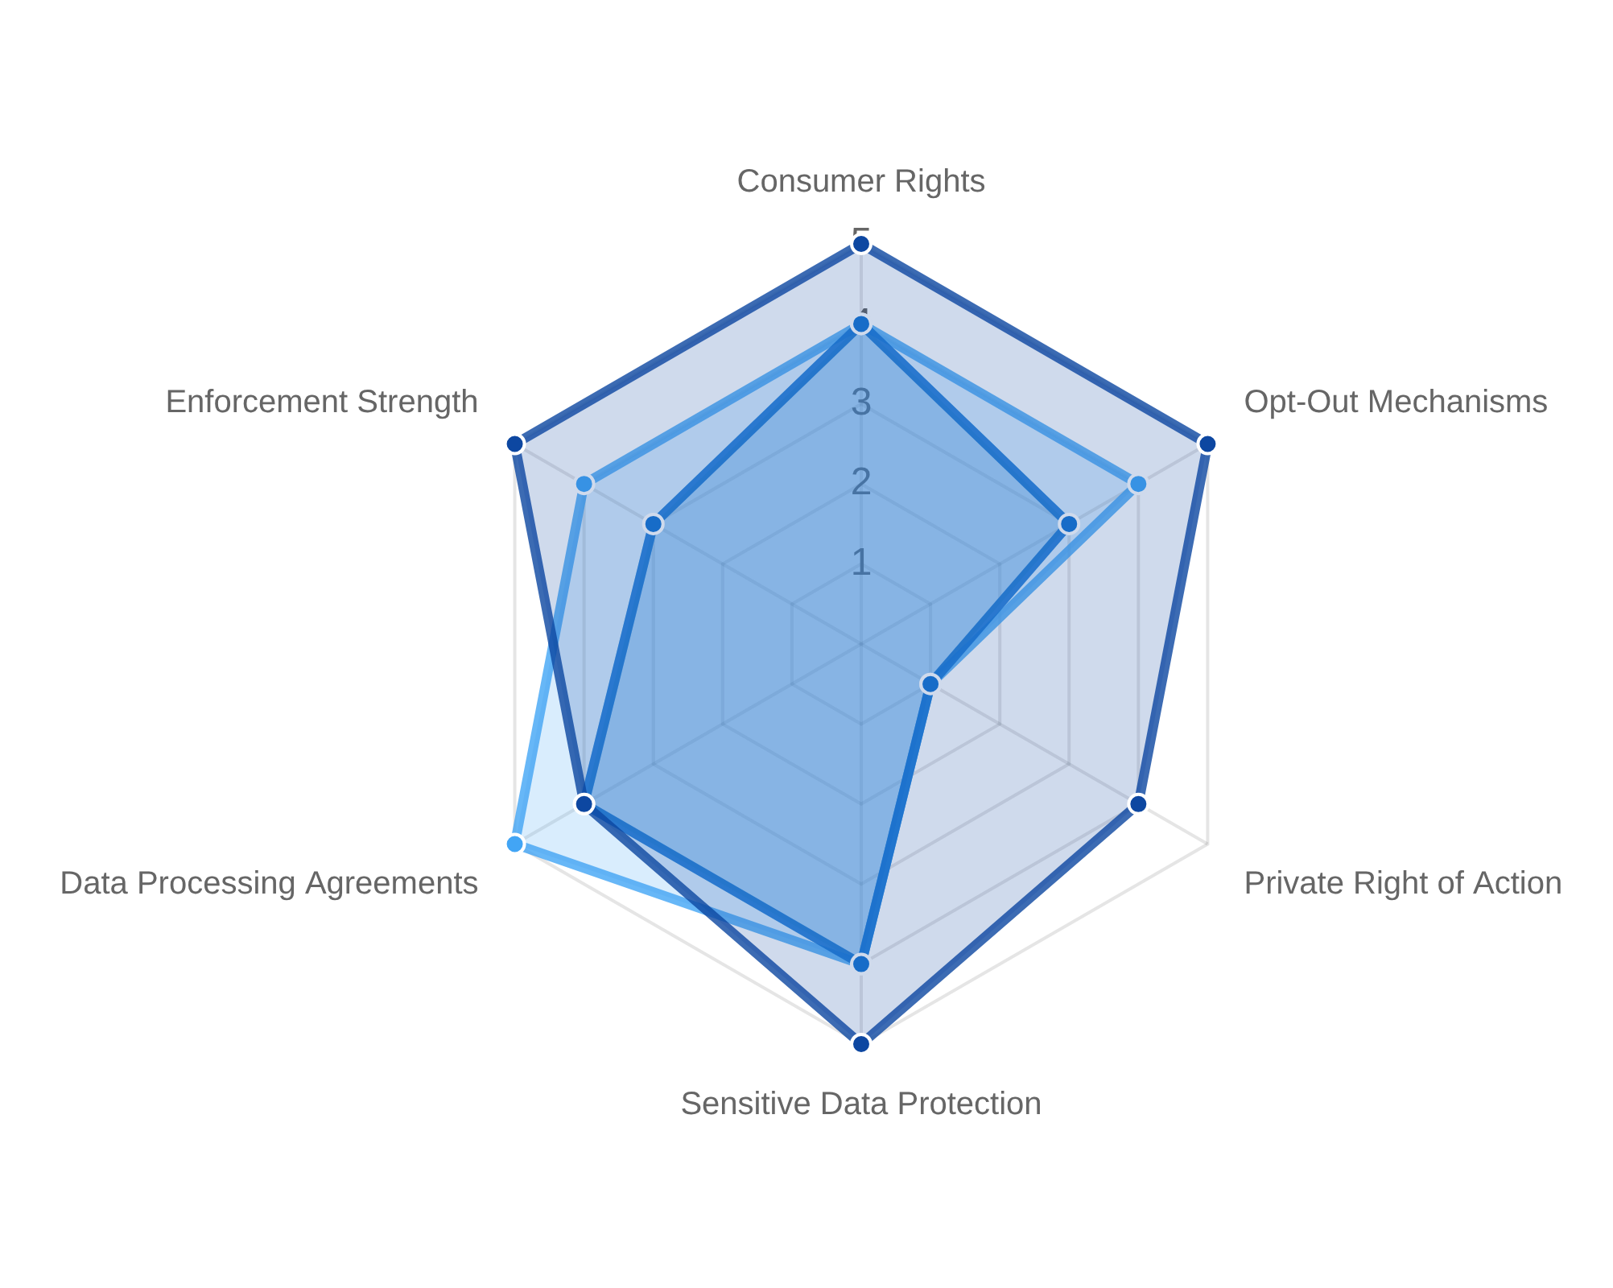
US State Privacy Laws: The CCPA Revolution
State-Level Privacy Framework
No comprehensive federal privacy law in the US
California led with CCPA (2020), enhanced by CPRA (2023)
Virginia, Colorado, Connecticut, Utah followed with similar laws
Key Consumer Rights
Right to know what data is collected
Right to delete personal information
Right to opt-out of data sales/sharing
Business Impact
Companies must comply with a patchwork of state laws with
different thresholds, requirements, and enforcement
mechanisms. CCPA applies to businesses with:
Annual revenue over $25 million, or
Data on 100,000+ California consumers, or
CCPA/CPRA (CA)
CDPA (VA)
CPA (CO)
CTDPA (CT)
50%+ revenue from selling consumer data
Global Data Privacy Regulations: A Comprehensive Overview
6

Slide 34



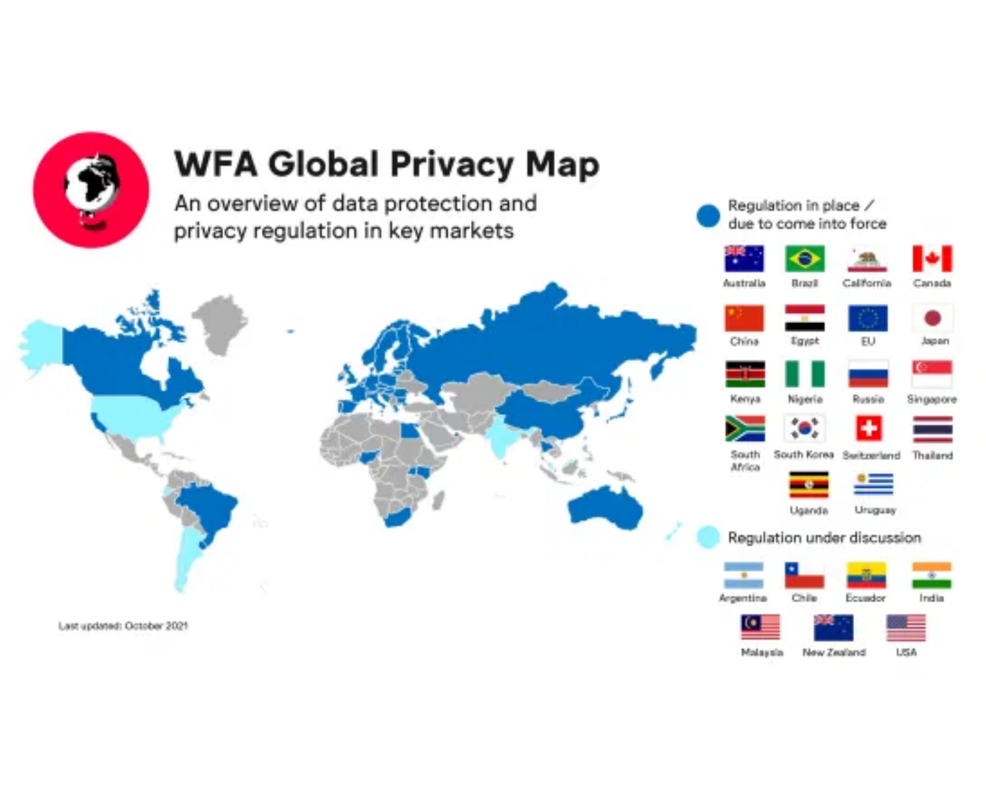
Asia-Pacific: Diverse Approaches to Privacy Protection
China: PIPL (2021)
China's first comprehensive personal information protection law
Strict cross-border data transfer restrictions
Mandatory security assessments for large data processors
Japan: APPI (Amended 2020)
First Asian country to receive EU adequacy decision
Balance between business needs and individual rights
Facilitates cross-border data flows with EU
India: DPDPA (2023)
New framework after years of legislative development
Risk-based approach with significant exemptions
Regional Trends
Data localization requirements increasing (China, Vietnam)
Singapore PDPA: Business-friendly approach with balanced protections
Asia-Pacific Privacy Regulatory Landscape (Source: World Federation of Advertisers, 2024)
Australia: Privacy Act with Notifiable Data Breaches scheme
South Korea PIPA: Among the strictest in the region
Global Data Privacy Regulations: A Comprehensive Overview
7

Slide 35


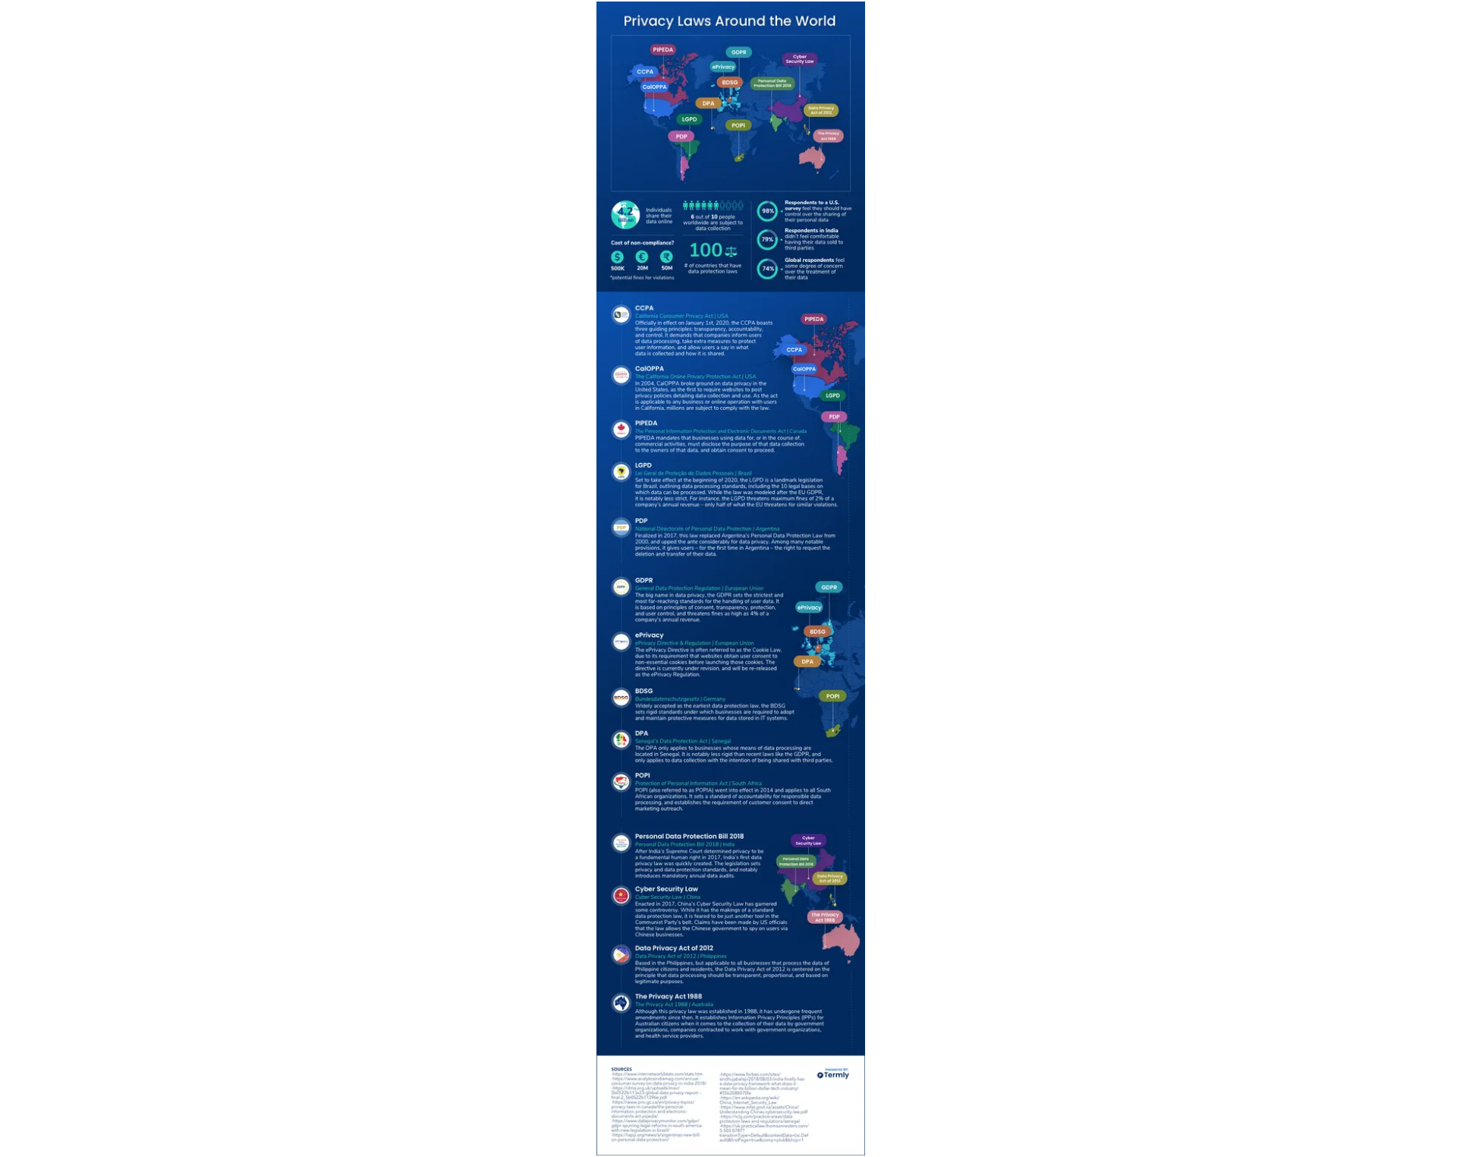





Global Privacy Laws: Regional Approaches
Brazil: LGPD (2020)
GDPR-inspired with local adaptations, penalties up to 2% of revenue
Canada: PIPEDA (2001)
Federal law with provincial variations, based on 10 fair information principles
UK: UK GDPR (2018)
Post-Brexit framework aligned with EU GDPR but with UK-specific adaptations
South Africa: POPIA (2020)
African data protection leadership, eight conditions for lawful processing
UAE: Data Protection Law (2022)
Middle East modernization, GDPR-influenced with special provisions for free zones
Key Regional Differences
Data localization requirements
Enforcement mechanisms
Privacy Laws Around the World (Source: Termly, 2024)
Cross-border transfer rules
Breach notification timelines
Global Data Privacy Regulations: A Comprehensive Overview
8

Slide 36



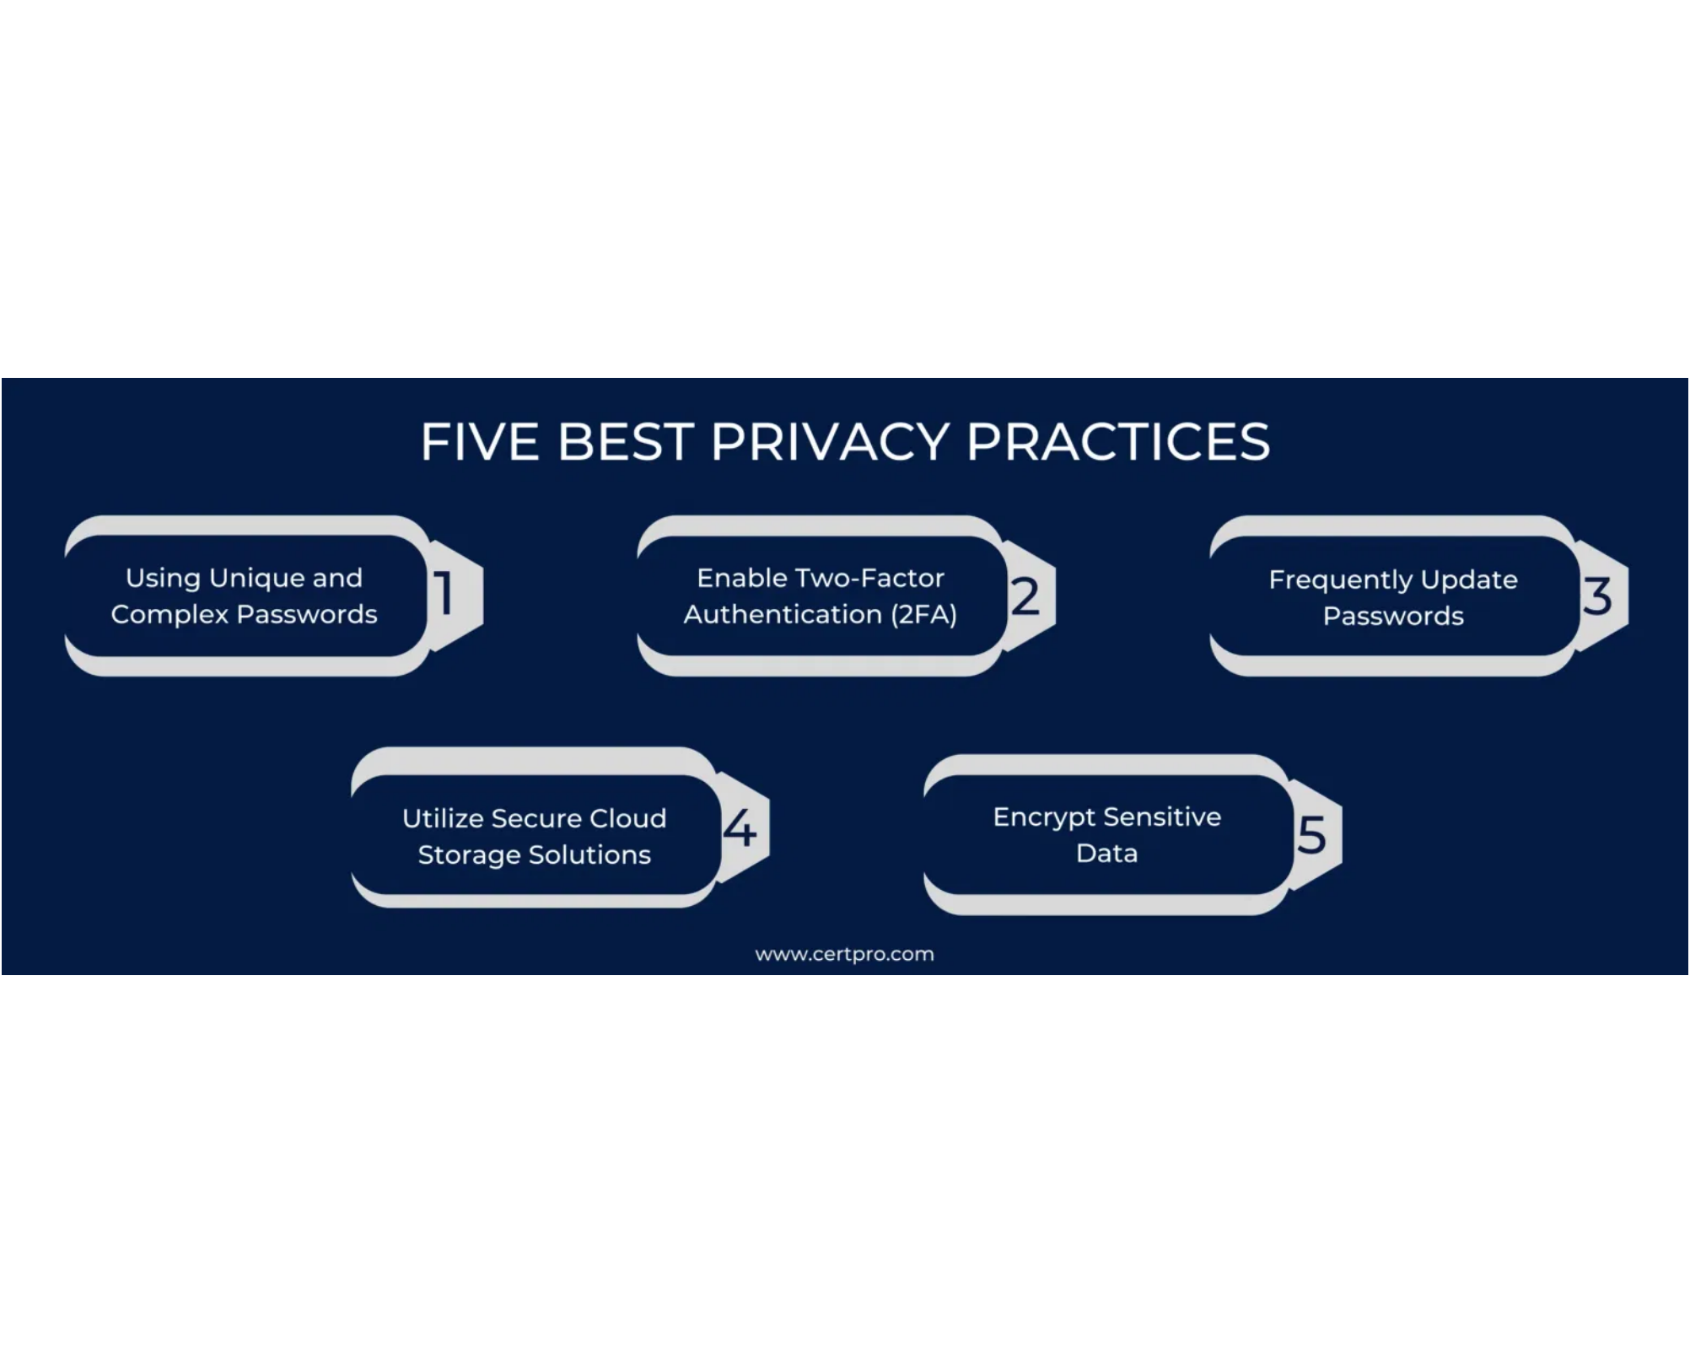




Navigating Multi-Jurisdictional Compliance
Key Compliance Challenges
Jurisdictional Complexity
Navigating overlapping laws with conflicting requirements across multiple countries and regions
Consent Management
Different standards for valid consent across jurisdictions (opt-in vs. opt-out, explicit vs. implicit)
Cross-Border Transfers
Complex adequacy decisions, SCCs, BCRs, and data localization requirements
Breach Notification
Varying notification requirements and timelines (72 hours under GDPR vs. 30-60 days elsewhere)
Best Practices
Privacy by design approach with global baseline standards
Data Privacy Best Practices Framework (Source: CertPro, 2024)
Comprehensive data mapping and inventory
Unified privacy program with local adaptations
Regular compliance assessments and training
Global Data Privacy Regulations: A Comprehensive Overview
9

Slide 37




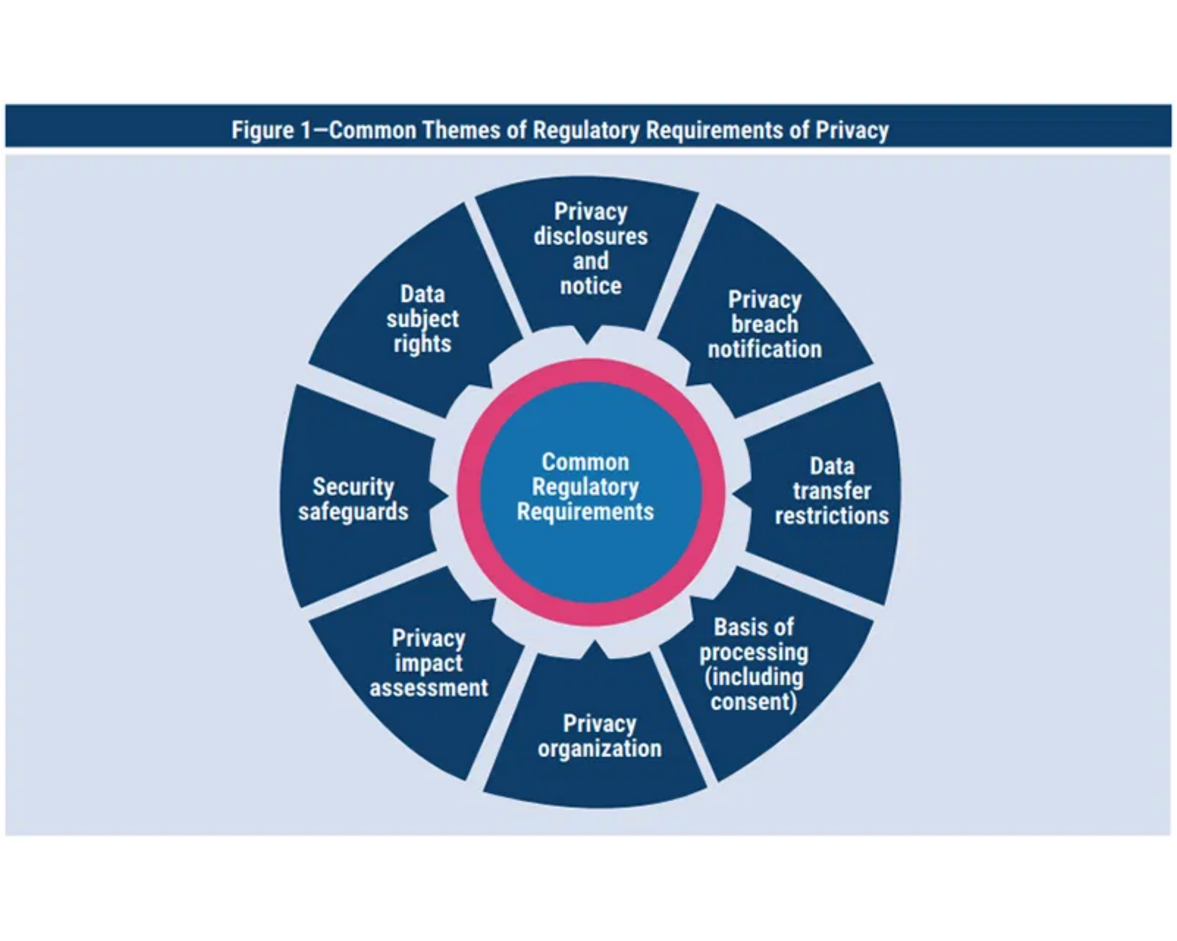



The Future of Global Privacy Regulation
Emerging Trends
AI Regulation
Increasing focus on automated decision-making, algorithmic transparency, and AI ethics frameworks (EU AI Act, US AI Bill of Rights)
Biometric Data Protection
Stricter controls on facial recognition, fingerprints, and other biometric identifiers with enhanced consent requirements
Children's Privacy
Age verification mandates, special protections for minors' data, and restrictions on profiling and targeted advertising
Data Portability & Interoperability
Enhanced rights to move data between services and platforms, with standardized data formats and transfer protocols
Strategic Recommendations
Adopt privacy by design as a foundational principle
Implement flexible compliance frameworks that can adapt to evolving regulations
Invest in privacy-enhancing technologies (PETs) and data minimization
Common Themes of Regulatory Requirements in Privacy (Source: ISACA, 2024)
Global Data Privacy Regulations: A Comprehensive Overview
10

